Slide 1


Lost and Found
By Oliver Jeffers
Year 1 - Autumn 1 Vocabulary

Slide 2

decide
To make a choice about something
Can we think of a sentence …
I will decide in the morning if I am going to have school lunch or sandwiches.

Slide 3


check
To look at something again to make sure it is ok.
Can we think of a sentence …
I will check my book bag to make sure I have my reading book today.

Slide 4

disappointment
To be a little sad about something that you were expecting.
Can we think of a sentence …
You could see the disappointment on her face. She was hoping for sunshine to go to the park.

Slide 5
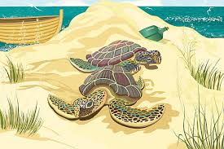
discover
To find out something new that you didn’t know before.
Can we think of a sentence …
He was happy to discover the beach had baby turtles on it!

Slide 6
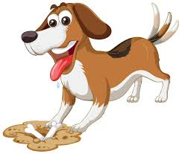
delight
To be happy or pleased about something.
Can we think of a sentence …
The puppy barked in delight when he saw a juicy bone in a hole.

Slide 7

wonderful
Something that is really good, something amazing.
Can we think of a sentence …
Our world is full of wonderful plants and animals.

Slide 8
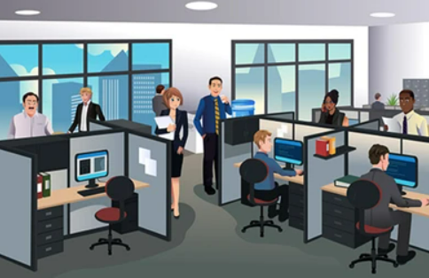
office
A place (a room or building) that you may go to work.
Can we think of a sentence …
They had to get to the office quickly because the train was late.

Slide 9

Well Done!
We have learned lots of new words this half term!

