Slide 1
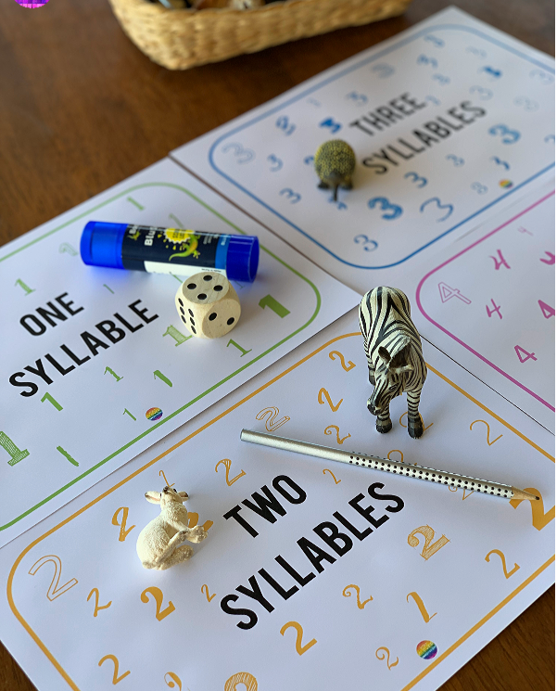
Syllables
Can you find things around your home with different syllables and sort them onto the correct syllable mat?

Slide 2




One
Syllable

Slide 3








Two
Syllables

Slide 4

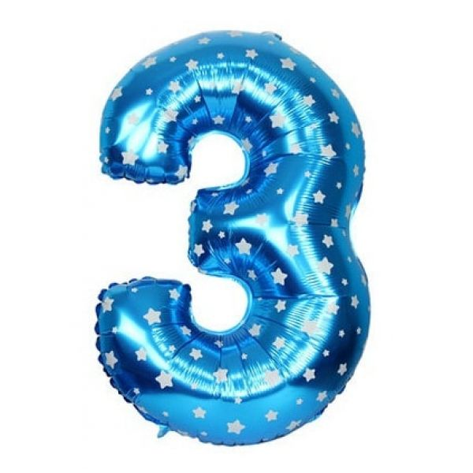


Three
Syllables

Slide 5




Four
Syllables

