Slide 2

Introduction
Would you like to play hide and seek?
We are hiding in the park. Click on us when you can see where we are hiding.
See if you can count us and find out how many bears are playing hide and seek.
Play

Slide 3
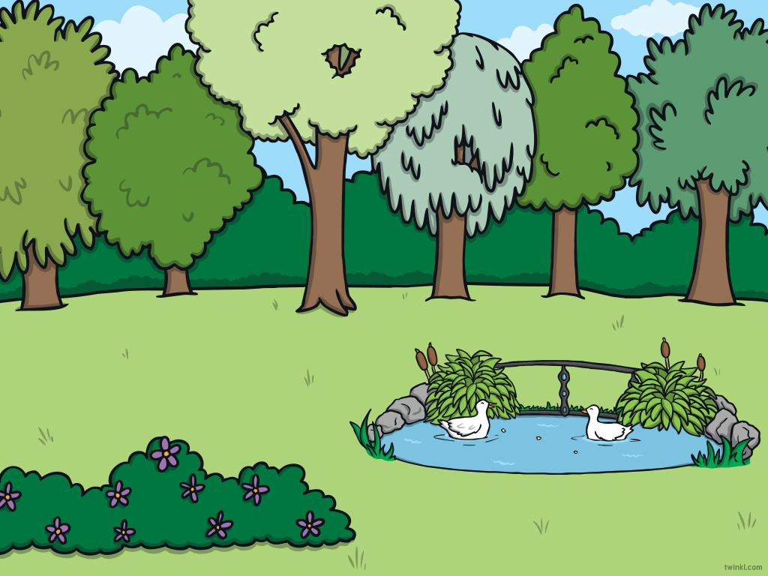




The bears are playing hide and seek. Click on the bears as you find them.
back
How many bears are playing hide and seek?
next

Slide 4
The bears are playing hide and seek. Click on the bears as you find them.
back
Two bears were by the pond and one was near the tree.
How many bears altogether?
next

Slide 5
The bears are playing hide and seek. Click on the bears as you find them.
back
Two bears were by the tree and one was near the pond.
How many bears altogether?
next

Slide 6


The bears are playing hide and seek. Click on the bears as you find them.
Two bears are hiding behind the bush. How many bears are
hiding in the tree? How many altogether?
back
next

Slide 7
The bears are playing hide and seek. Click on the bears as you find them.
How many bears are playing hide and seek? How did you know that
you had found all of the bears?
back
next

Slide 8



The End
Thank you for playing hide and seek with us.

