Slide 1

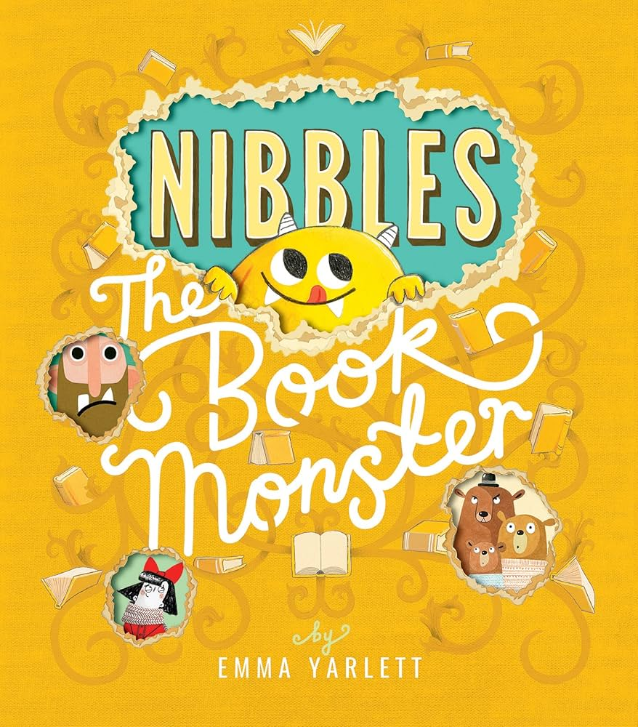
Nibbles by Emma Yarlett
Year 1 - Autumn 2 Vocabulary

Slide 2
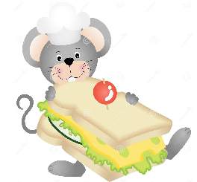
nibble
To bite or chew gently or bit by bit (noun)
Can we think of a sentence …
The mouse had just a small nibble of my cheese sandwich!

Slide 3
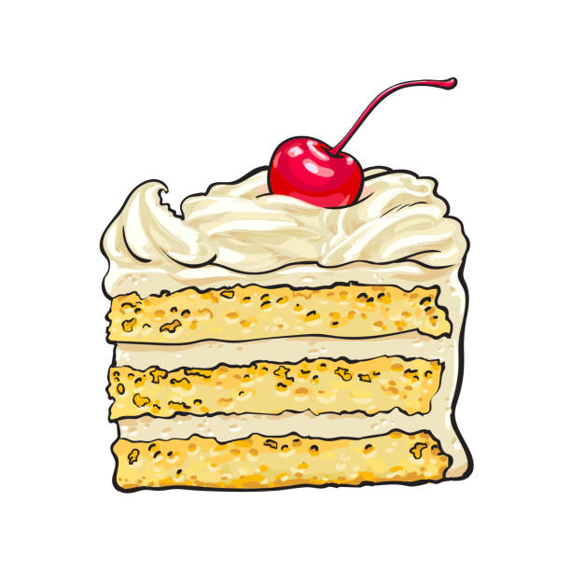
chomp
To chew or bite on something. (verb)
Can we think of a sentence …
I chomped hungrily through the large slice of cake.

Slide 4

curious
To want to learn more about something (adjective)
Can we think of a sentence …
They were curious to find out what the strange footprint belonged to.

Slide 5
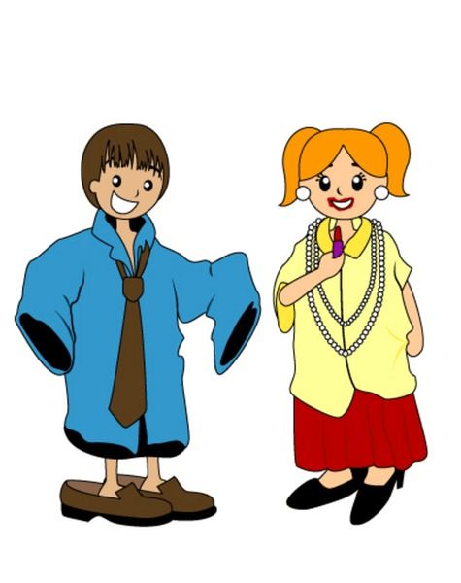
rascal
A naughty or mischievous person. (noun)
Can we think of a sentence …
I saw those little rascals dressing up in my clothes new clothes!

Slide 6
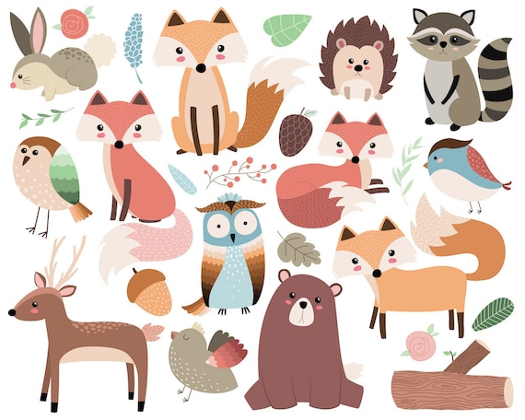
critter
A living creature or an animal (noun)
Can we think of a sentence …
The woods are filled with skunks, raccoons, and other critters.

Slide 7
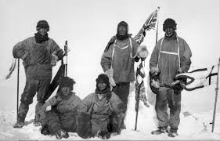
adventure
An unusual or exciting experience that may have some unknown risk (noun)
Can we think of a sentence …
The explorers went on an adventure to the South Pole.

Slide 8
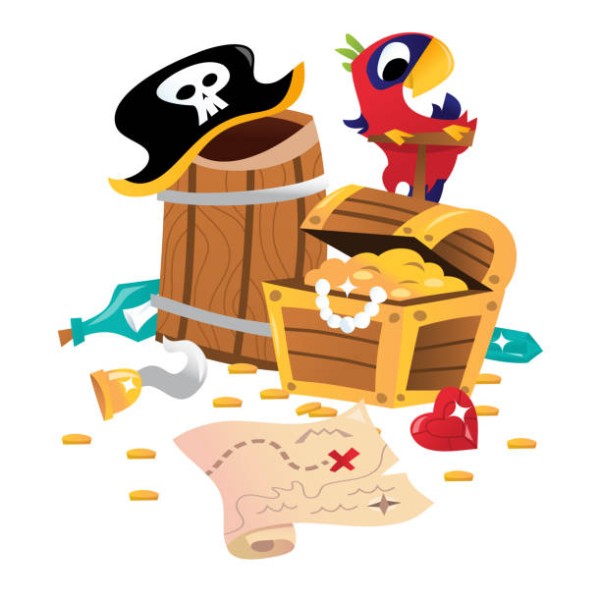
nab
To take something suddenly (verb)
Can we think of a sentence …
He managed to nab the treasure map from the pirates.

Slide 9
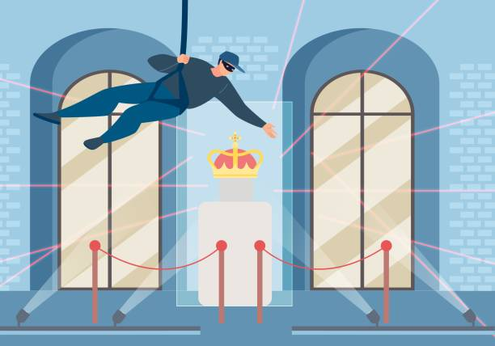
hullabaloo
A loud noise or fuss made by people who are angry or excited.(noun)
Can we think of a sentence …
There was a real hullabaloo when the crown jewels were stolen.

Slide 10
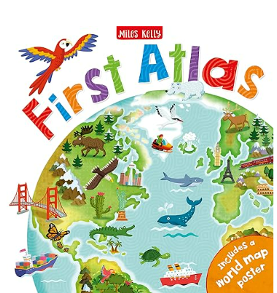
atlas
A book of maps or charts.(noun)
Can we think of a sentence …
I got my first atlas for my birthday!

Slide 11

Well Done!
We have learned lots of new words this half term!

