Slide 1

The Lighthouse at Butler’s
Our Vision

Slide 2
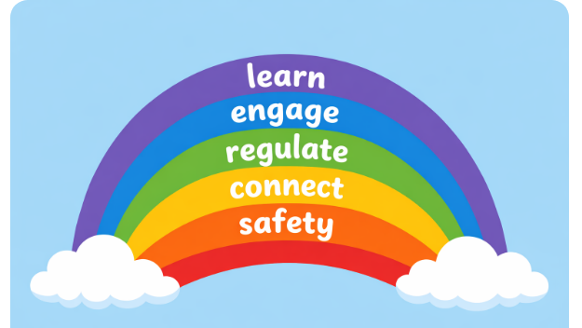

Slide 3
Nature of the provision
Strategies
Children may need time and space to regulate BEFORE learning can take place
Learning opportunities are often responsive and highly personalised
Staff regularly provide 1:1 support and targeted mental health interventions
Shared group times are often focused on engagement, connection and readiness to learn
Staff often need to respond quickly to moments of engagement. If those moments are interrupted it can result in the child disengaging and the opportunity for learning being lost
Recognising this difference in approach is important when considering expectations around teaching, observation and daily routines.
Wide range of needs
Sensory differences
SEMH
Communication and Interaction difficulties
Early trauma

Slide 4
Interventions list
Squiggle me into a writer/while you wiggle
Colourful Semantics
Blanks
Narrative
Language for Thinking
ELSA informed bespoke interventions – emotions, bereavement etc
ELS Phonics interventions
1:1 Phonics/Maths
Fun fit
Sensory Circuits

Slide 5
Strong Foundations
Communication & Language priority (rich talk, vocabulary, interactions)
High-quality adult–child interactions (modelling, questioning, extending thinking)
Well-sequenced curriculum (clear progression from starting points)
Secure early literacy & maths foundations (phonics, number sense)
Assessment used effectively (inform teaching, not excessive)
Early identification of SEND and timely support
Language-rich environment (stories, songs, meaningful talk)
Focus on independence & self-regulation
Strong routines & behaviour expectations
Partnership with parents/carers
→ Builds readiness for Year 1 and beyond

Slide 6
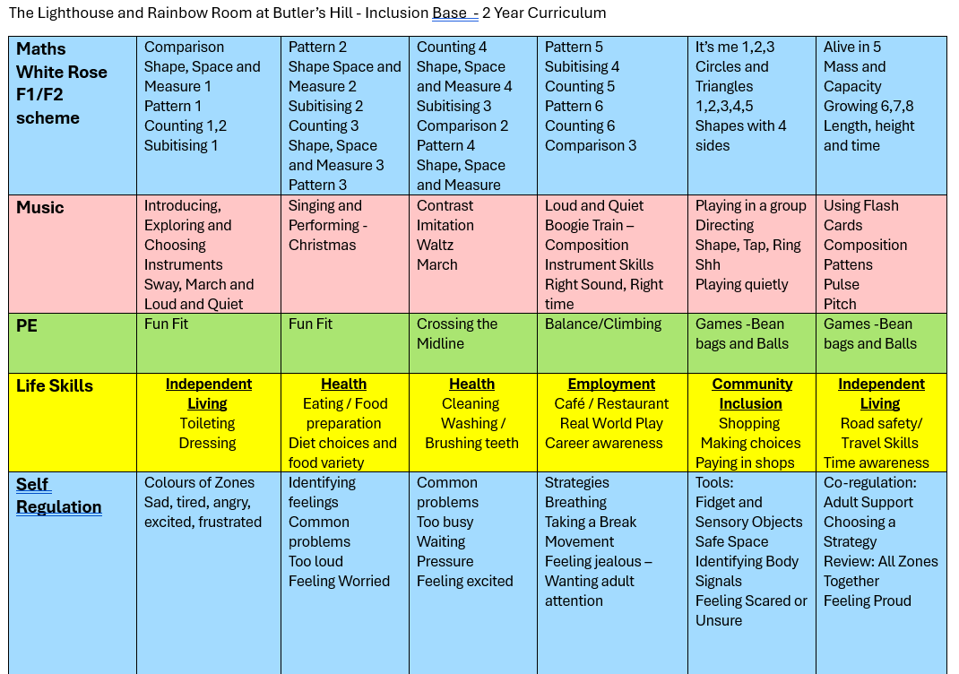
Curriculum

Slide 7
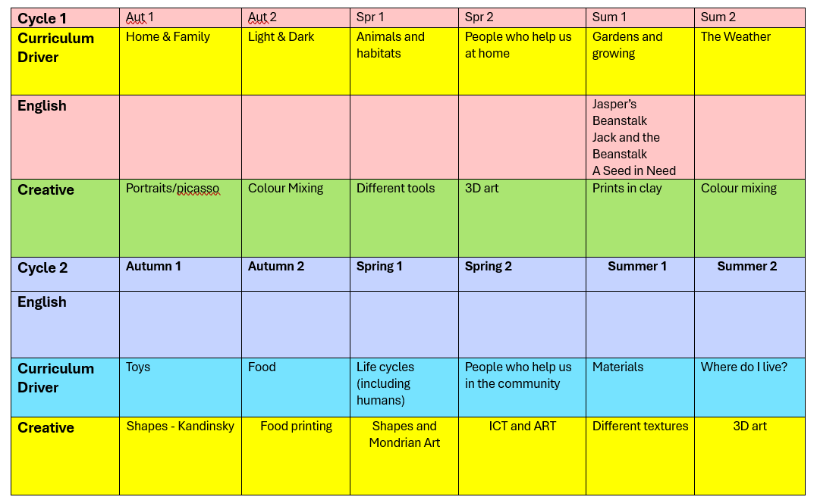

Slide 8
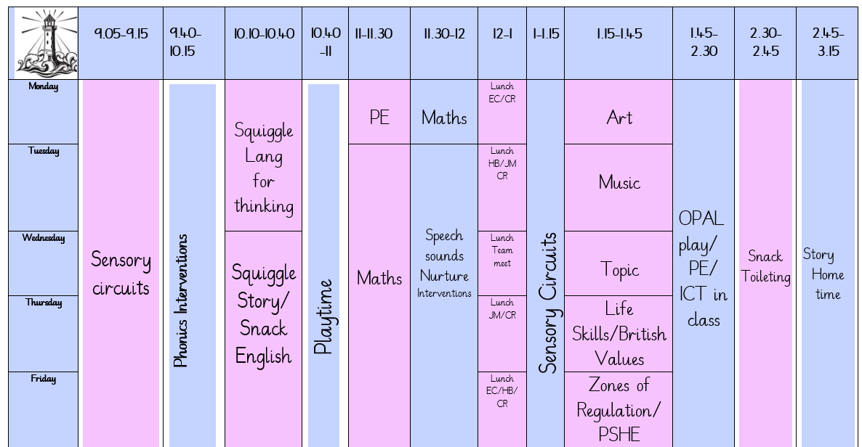
Timetable

Slide 9
Assessments
Track children using Bsquared
Primary Steps in Reading, Writing and Maths Aut 2, Spr 2, Sum 2
SEMH Aut 1, Spr 1, Sum 1
Track Phonics; GPCs, Blending and HRS words half termly
Baselines and end of year for Fun Fit, Language for Thinking

Slide 10
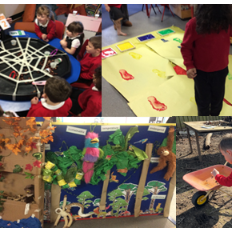
Admissions
Who would benefit from the EPU? Admission Criteria
Children may exhibit the following:
· Communication and Interaction as main area of need.
· Limited spoken/expressive language. Approx 2-3 word phrases
· Can make basic requests to meet own needs.
· Is working at Progression Step 1-2 on BSquared.
· NOT at risk of suspension.
· Difficulties in making and maintaining relationships.
· Difficulties in following instructions and accepting adult direction and maintaining attention to task.
· An unusual response to some sensory stimuli e.g. may find noisy/busy classroom environments dysregulating.
· Evidence of rigid thought, making the pupil inflexible and unlikely to cope with change, resulting in significant signs of stresses and anxiety.

Slide 11
Training
Beth Atkinson SALT training
Attention Autism SIS,
SIS Sensory regulation,
Lightbulb – Mental Health
Supporting Children with ADHD in the Primary Classroom,
SEND in the curriculum,
Sensory Circuits,
Forest school
Interoception

