Slide 1


Vision
At Butler’s Hill we seek to inspire children to, ‘Dream big, aim high’, to have high aspirations and believe that they can make a difference in this ever changing world. Our vision is to ensure that our pupils receive the very best education, to realise their potential, in a supporting and caring environment, enabling them to lead a full, purposeful and happy life. Through our vision, we aim to EQUIP our pupils with the best set of key skills and knowledge, delivered by ‘High Quality, High Impact’ teaching and learning. EMBEDDING this through an engaging, purposeful and challenging curriculum. ENRICHING pupils’ learning experiences by providing a wealth of opportunities to motivate and inspire them to become life- long learners.

Slide 2
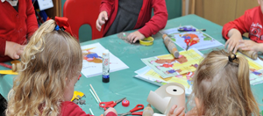
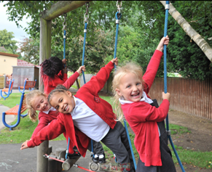
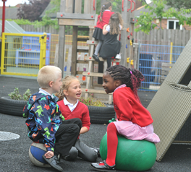

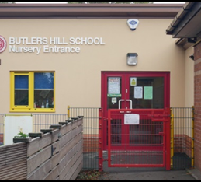
Welcome to Butler’s Hill Infant & Nursery
School
Mission Statement
We believe that high expectations, respect and a love of learning, contributes to success in school and in later life. Through our engaging curriculum, personalised learning and supportive community, we enable our pupils to flourish, feel safe and believe in themselves.
Butler’s Hill Infant & Nursery School
Aims: Caring, Creative and Confident
Values: Respect, Responsibility & Resilience.

Slide 3


What do we believe?

Slide 4
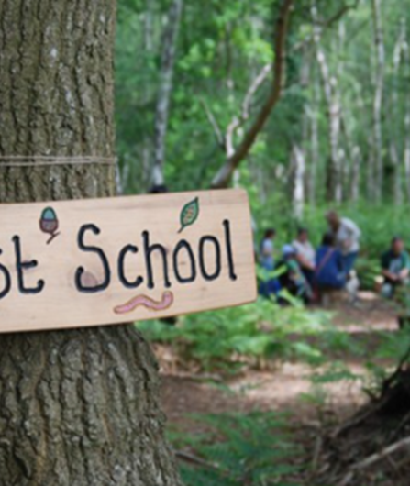
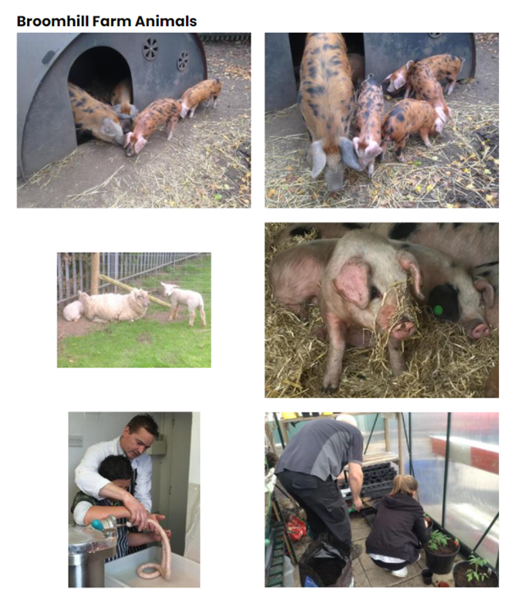
What can we offer?
Butler’s Hill and Broomhill are rated ‘good schools’
Wrap around care – Before school club
Partnership with Broomhill Juniors
A range of after school clubs
Before school clubs and holiday activities
Lime Trees After school provision
Health and family support
A farm (Broomhill site)
Forest school (Both sites)

Slide 5
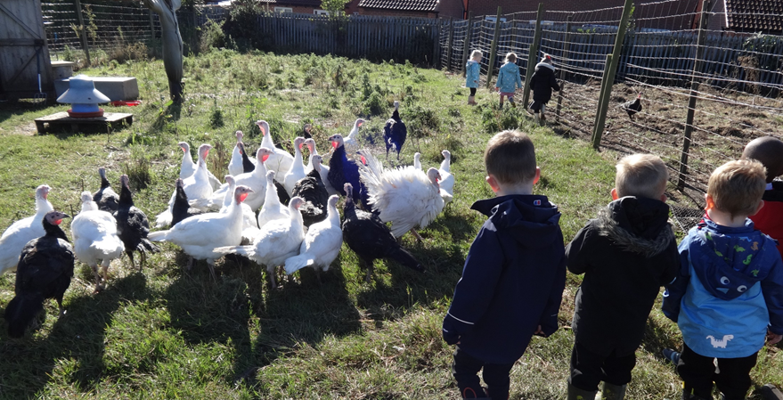

Slide 6
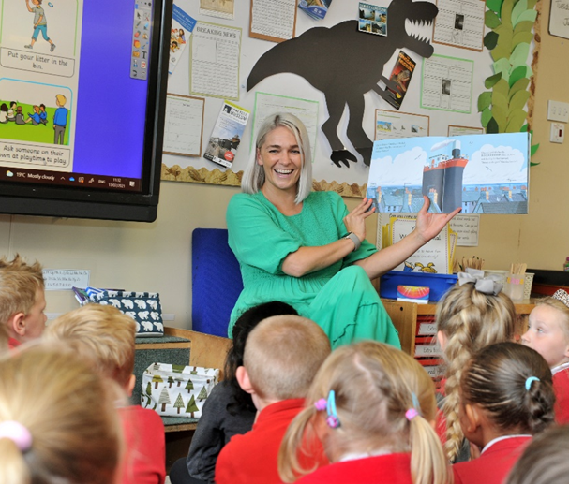
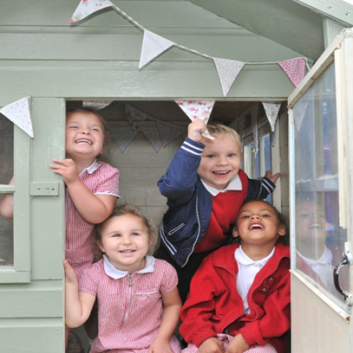
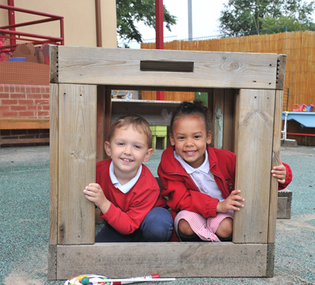
Committed and dedicated staff who genuinely care for the children
Learning through play
Ofsted continue to rate us as a ‘good’ school
Curriculum that engages and excites children to become life long learners
We understand and are committed to the development of the ‘whole child’ and acknowledge literacy and numeracy skills are essential but are only part of the education jigsaw.

Slide 7
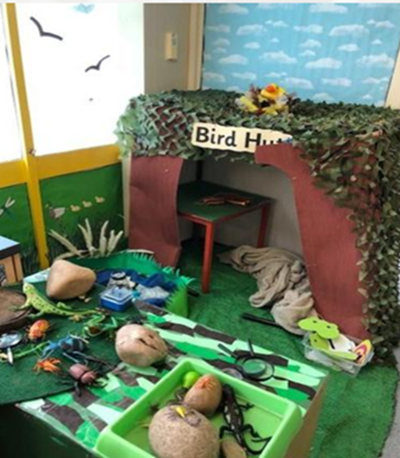
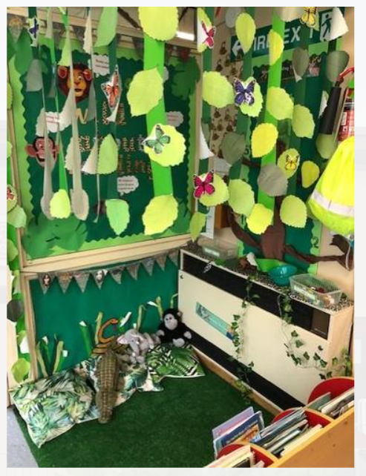
Creative learning environments

Slide 8
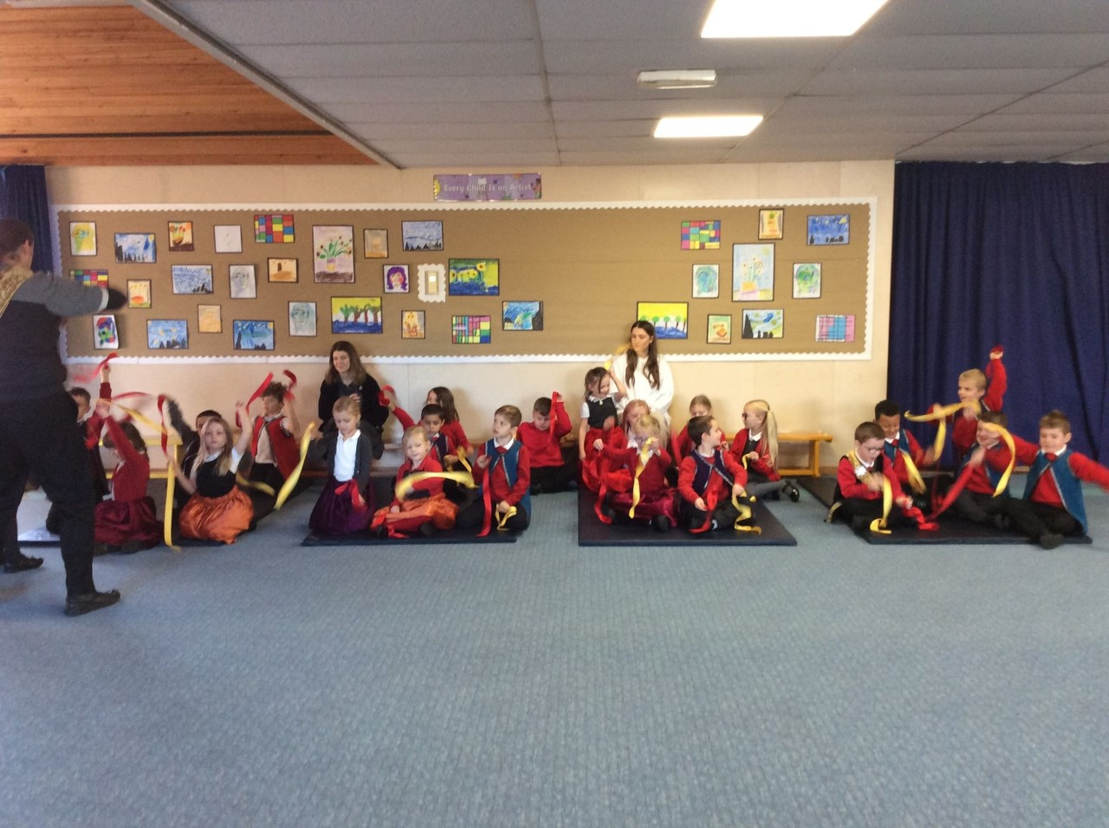
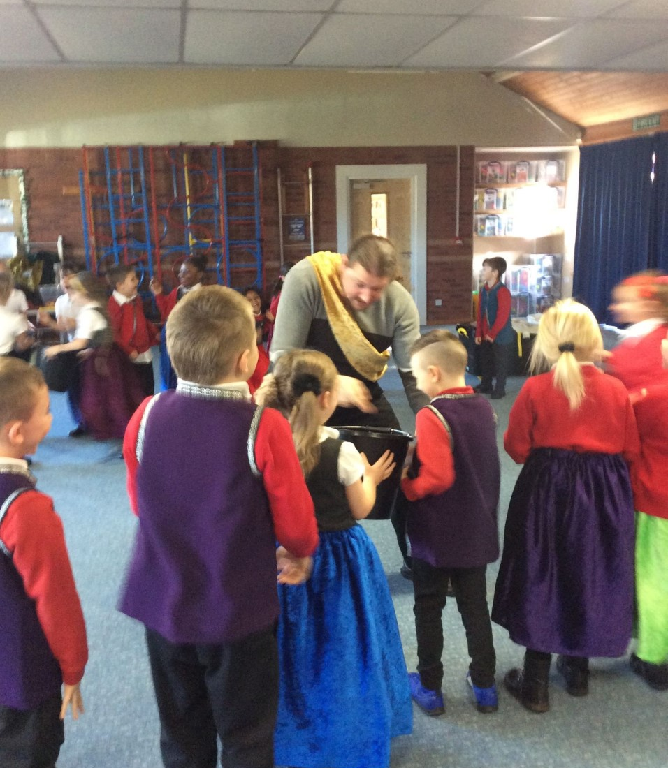
Enrichment activities and learning
At Butler’s Hill we make ‘learning irresistible’ sparking the interest, enthusiasm and curiosity in our children.

Slide 9

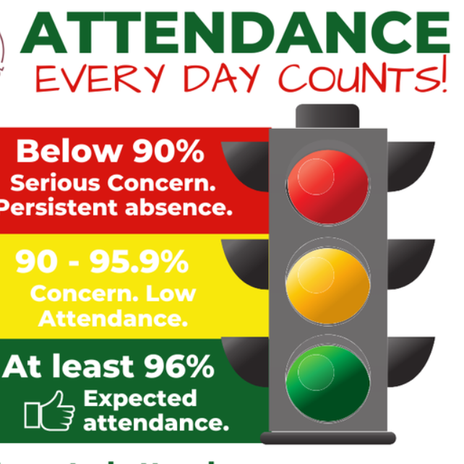
What do we need from you?
Attendance

Slide 10



Slide 11




What do people say about us!
Leaders have created a ‘family feel’ ethos. Staff are a united team, and are keen to
involve the local community in the learning opportunities planned for pupils and in their
charity work’.
Bullying doesn’t happen here – this is a kind school.
The first Butlers Hill's Got Talent - WOW!!!! I feel very proud to be a governor at this school and a judge on the panel for this event. There's so much talent at Butlers Hill, not just from what I witnessed today but every time I go into the school; which is quite regularly
Mark Spencer MP
It was great to see how much the children enjoyed being at school, with one class having lots of fun learning about creepy crawlies in particular. I can’t praise the staff and children enough from what I saw on my visit’.

Slide 12
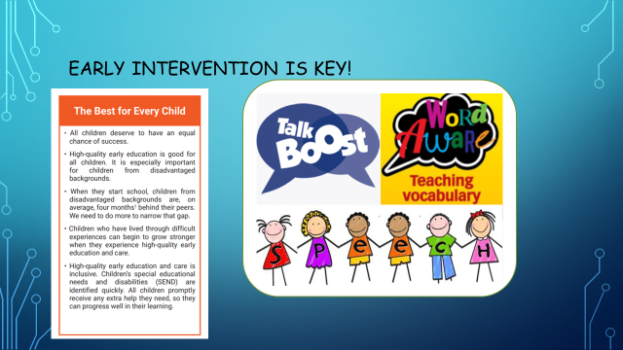

Early intervention is key!

Slide 13
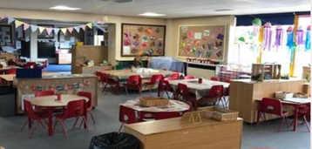
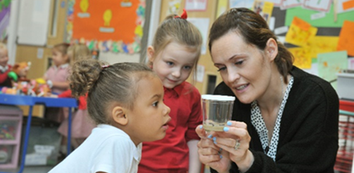
A typical school day
Nursery Session Times:
8.40 a.m. to 11.40 a.m
12.20 p.m. to 3.20 p.m
Infant Session Times:
8.45 a.m. to 3.15pm

Slide 14
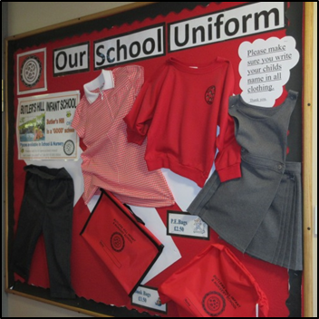
What next?
Apply online
https://www.nottinghamshire.gov.uk/education/school-admissions/apply-for-a-school-place
6 November 2023 – 15 January 2024 for first admission (reception) and transfer from infant to junior/primary education
National Offer day 16th April 2024
Arrange transition visits or consider Nursery sessions in the Summer Term
Buy your uniform
Any questions?

