Slide 1

Computing
At Butlers Hill Infant and Nursery School

Slide 2
Early Years and Computing
Despite computing not being explicitly mentioned within the Early Years Foundation Stage (EYFS) statutory framework, which focuses on the learning and development of children from birth to age five, there are many opportunities for young children to use technology to solve problems and produce creative outcomes. In particular, many areas of the framework provide opportunities for pupils to develop their ability to use computational thinking effectively.
Within the revised EYFS statutory framework, the Technology strand within Understanding the World has been removed. However, there are opportunities within each area of the framework to enable practitioners to effectively prepare children for studying the computing curriculum.

Slide 3
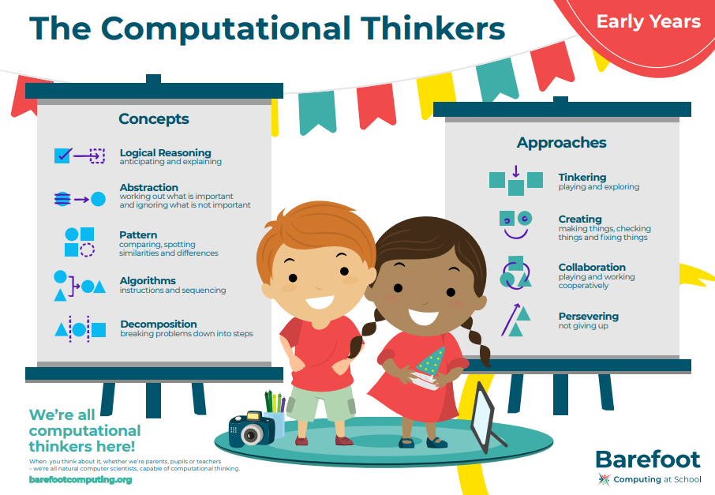
Early Years and Computing

Slide 4
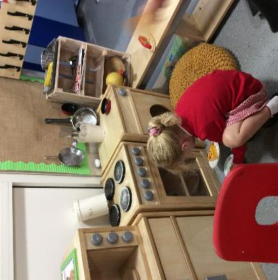
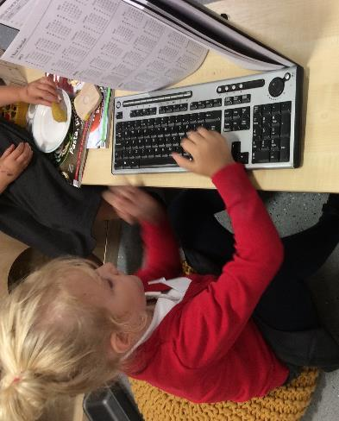
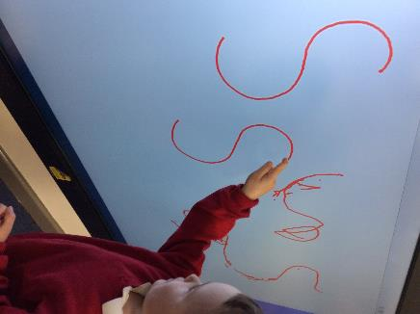
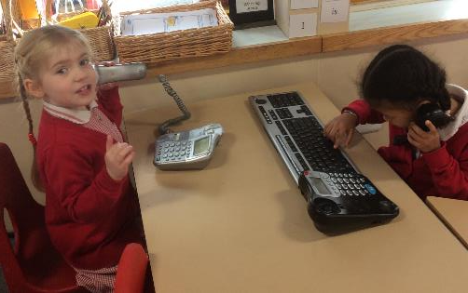
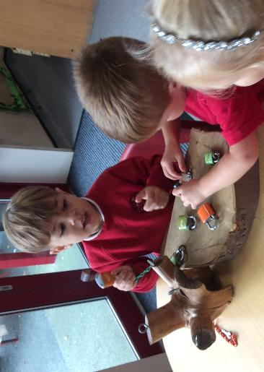
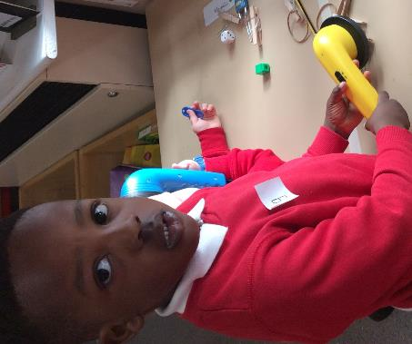
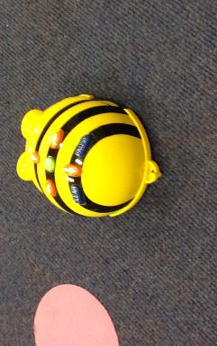

Slide 5
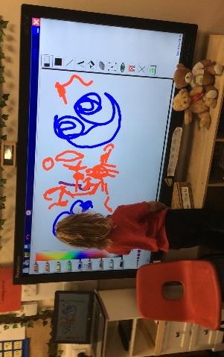
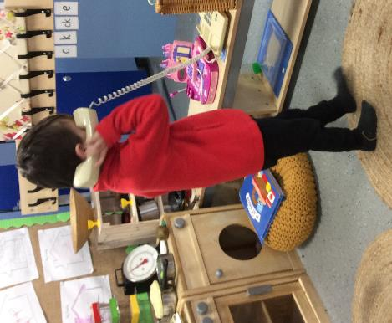
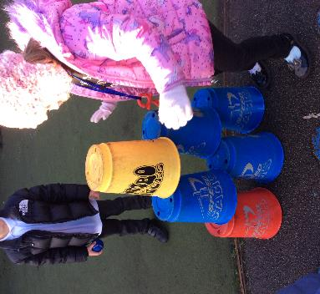
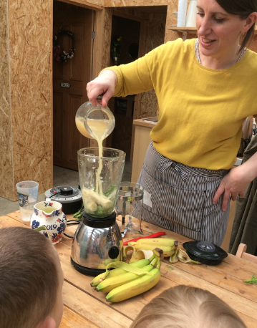
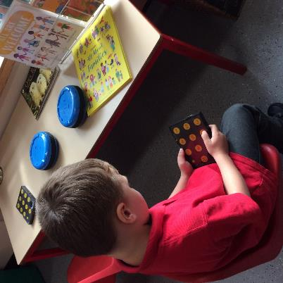
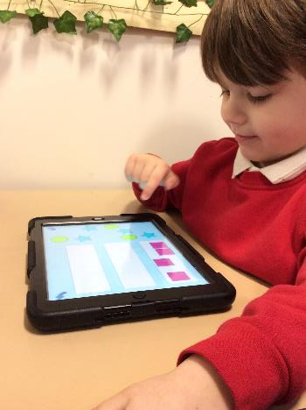

Slide 6
National Curriculum
Aims
The national curriculum for computing aims to ensure that all pupils:
can understand and apply the fundamental principles and concepts of computer science, including abstraction, logic, algorithms and data representation
can analyse problems in computational terms, and have repeated practical experience of writing computer programs in order to solve such problems
can evaluate and apply information technology, including new or unfamiliar technologies, analytically to solve problems
are responsible, competent, confident and creative users of information and communication technology.

Slide 7
National Curriculum
Key stage 1 Pupils should be taught to:
understand what algorithms are; how they are implemented as programs on digital devices; and that programs execute by following precise and unambiguous instructions
create and debug simple programs
use logical reasoning to predict the behaviour of simple programs
use technology purposefully to create, organise, store, manipulate and retrieve digital content
recognise common uses of information technology beyond school
use technology safely and respectfully, keeping personal information private; identify where to go for help and support when they have concerns about content or contact on the internet or other online technologies.

Slide 8
Computing at ks1
In KS1, computing is taught in discrete computing lessons every term. Teachers use the ‘Purple Mash’ scheme. Every lesson in the scheme has an individual plan to ensure it meets the needs of all pupils. Having discrete lessons means that the children are able to develop depth in their knowledge and skills over the duration of each of their computing topics. Where appropriate, meaningful links are made between the computing curriculum and the wider curriculum. Employing cross-curricular links motivates pupils and supports them to make connections and remember the steps they have been taught.

Slide 9

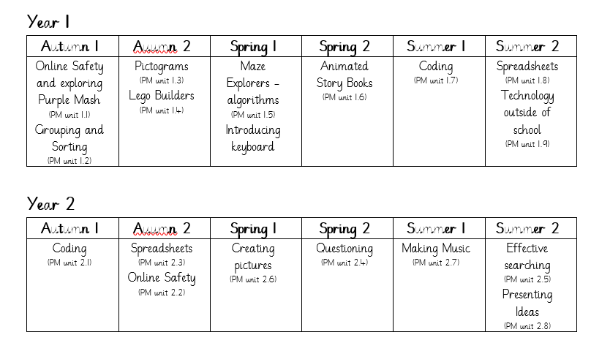
Long term plan

Slide 10
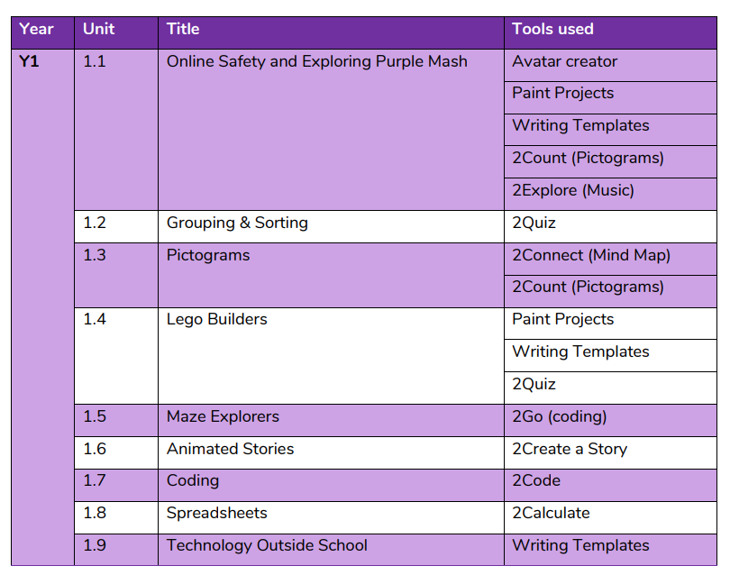
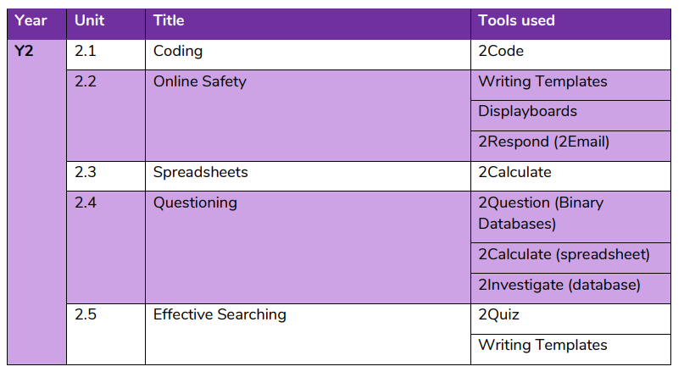
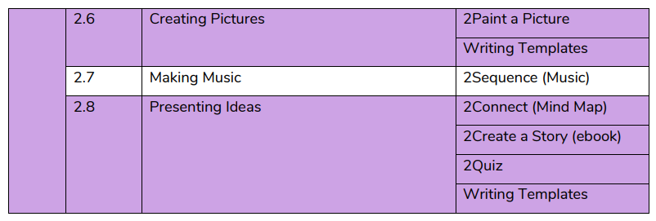
Tools by unit
The Purple Mash Scheme provides opportunities for links with the wider curriculum.

Slide 11
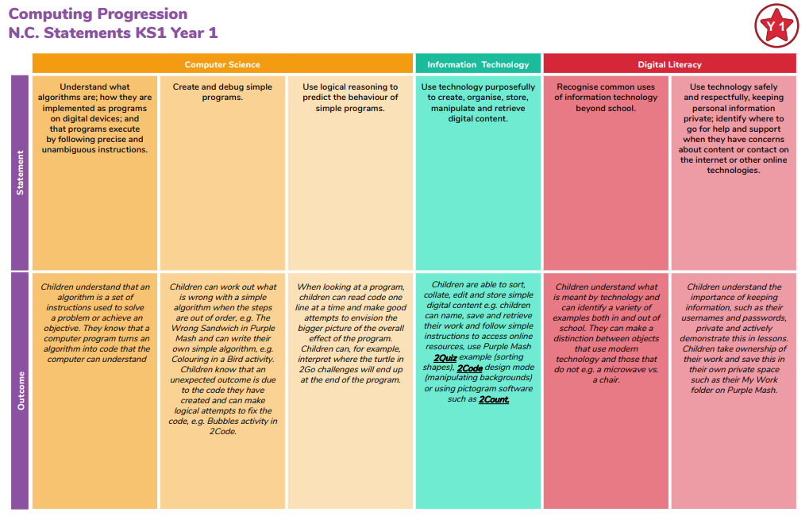
Computing Progression

Slide 12
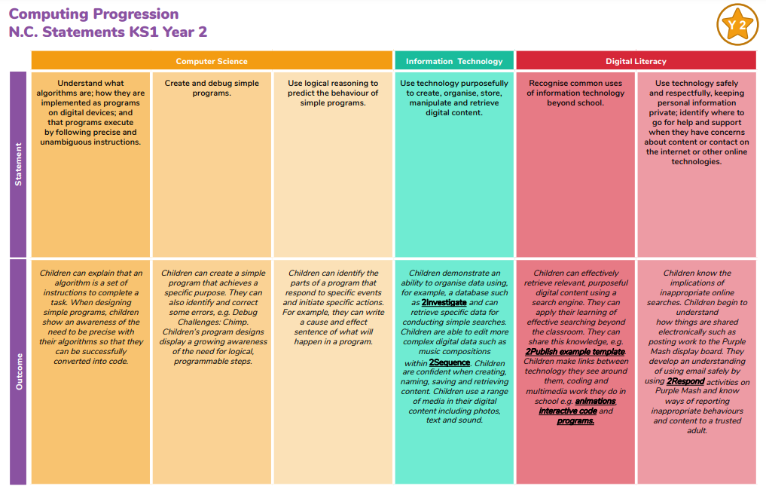
Computing Progression
Progression in each unit is clear e.g. Algorithms in year 1 – follow instructions, organise instructions, create a simple algorithm,
debug algorithm (then in year 2 – predict what will happen).

Slide 13
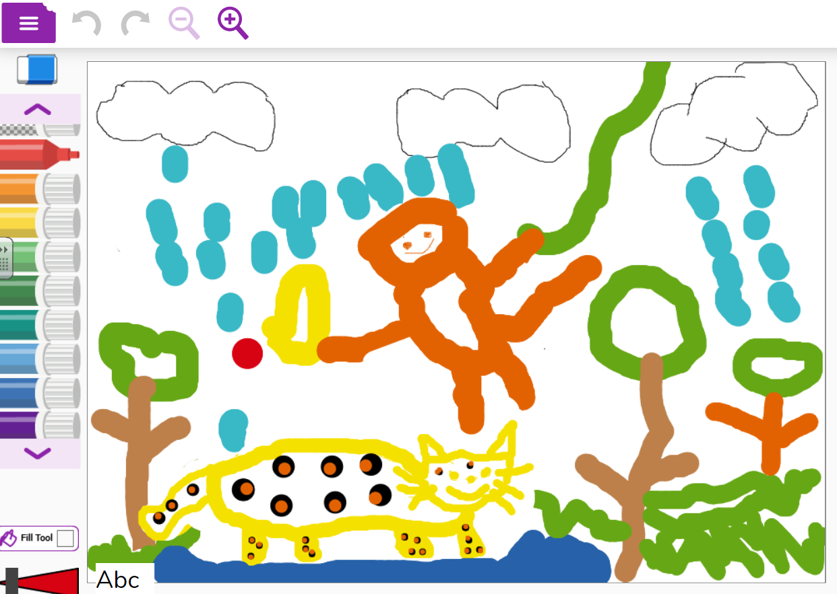
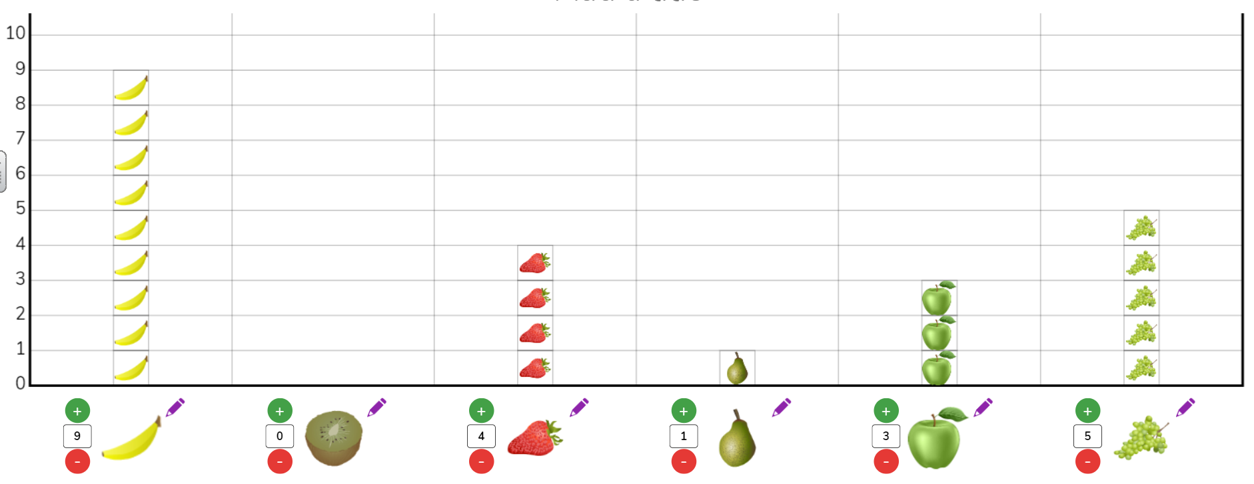
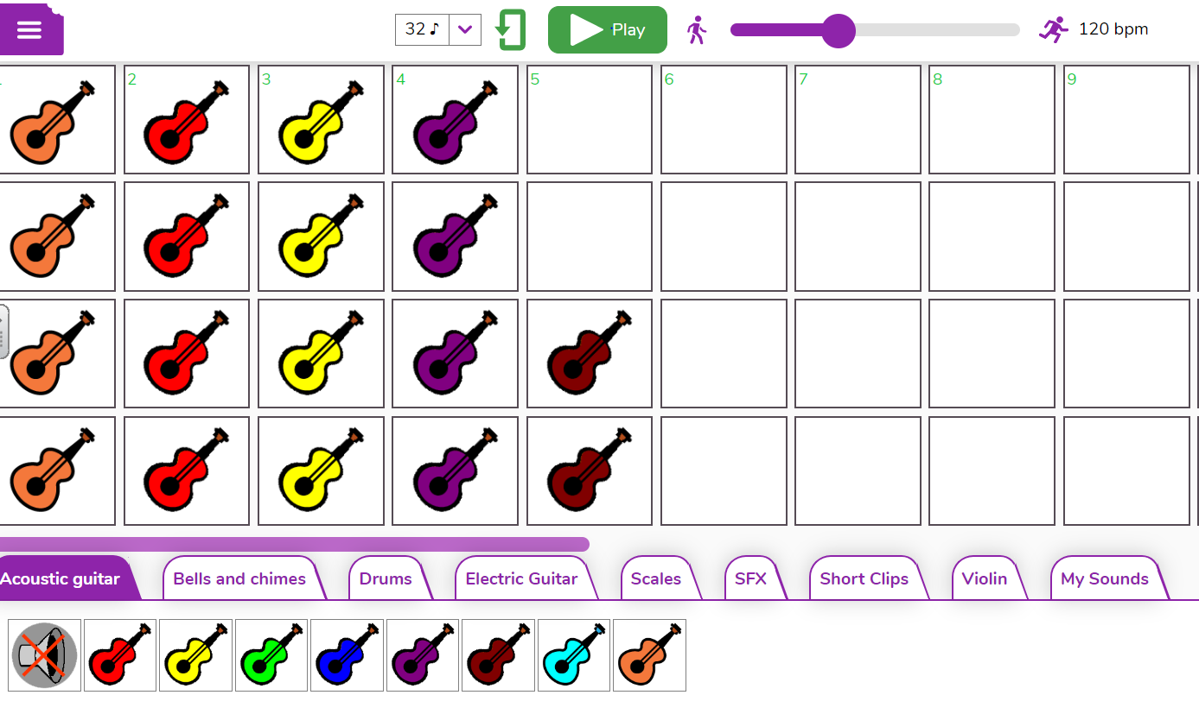
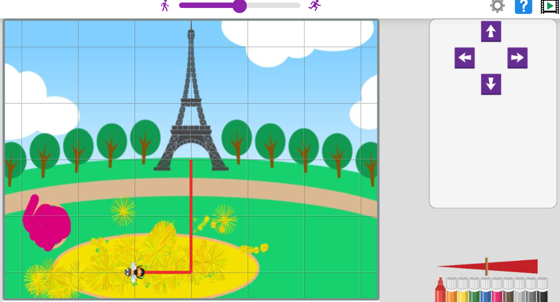
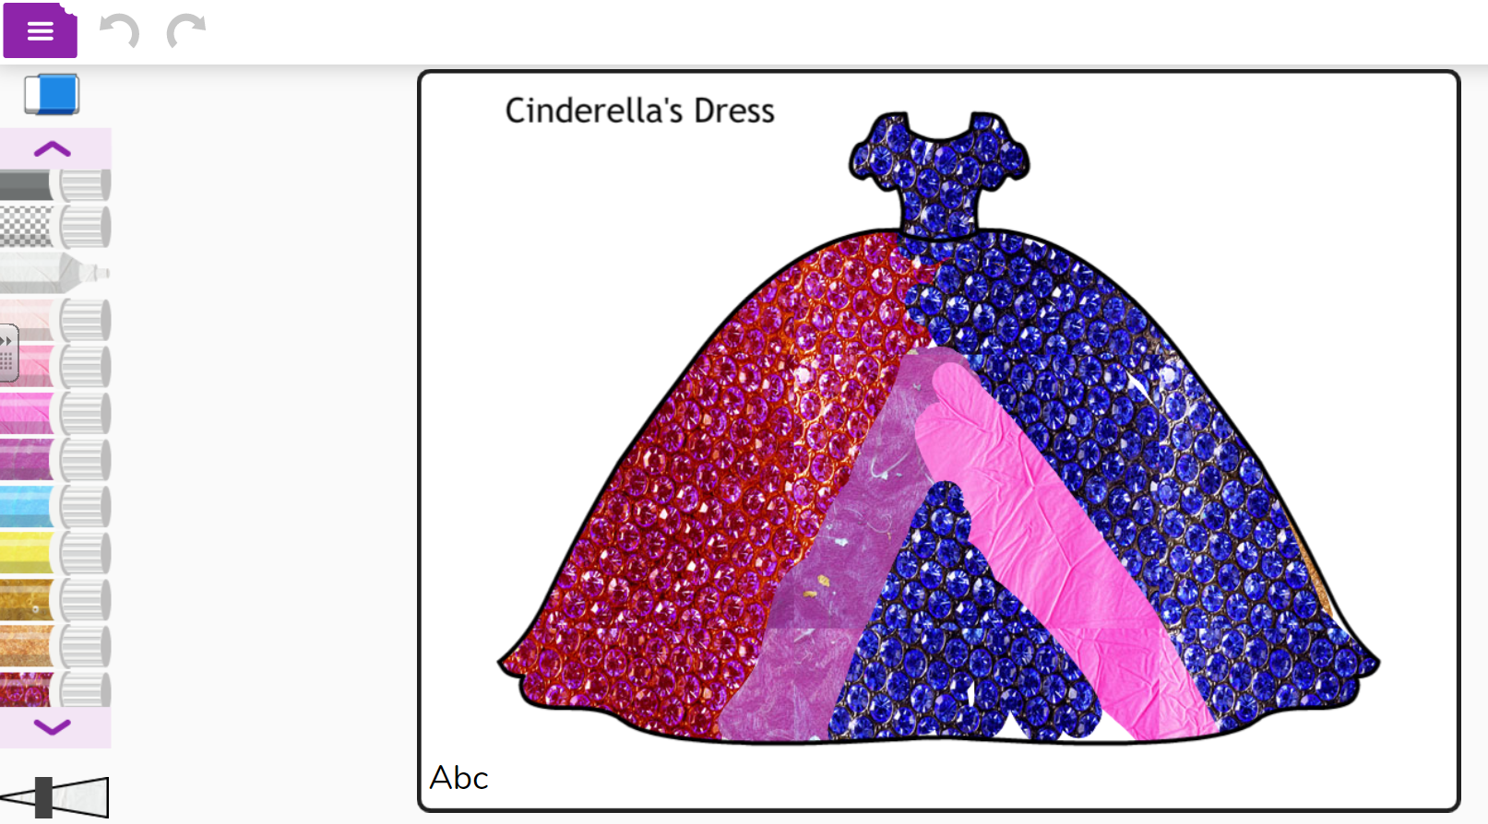
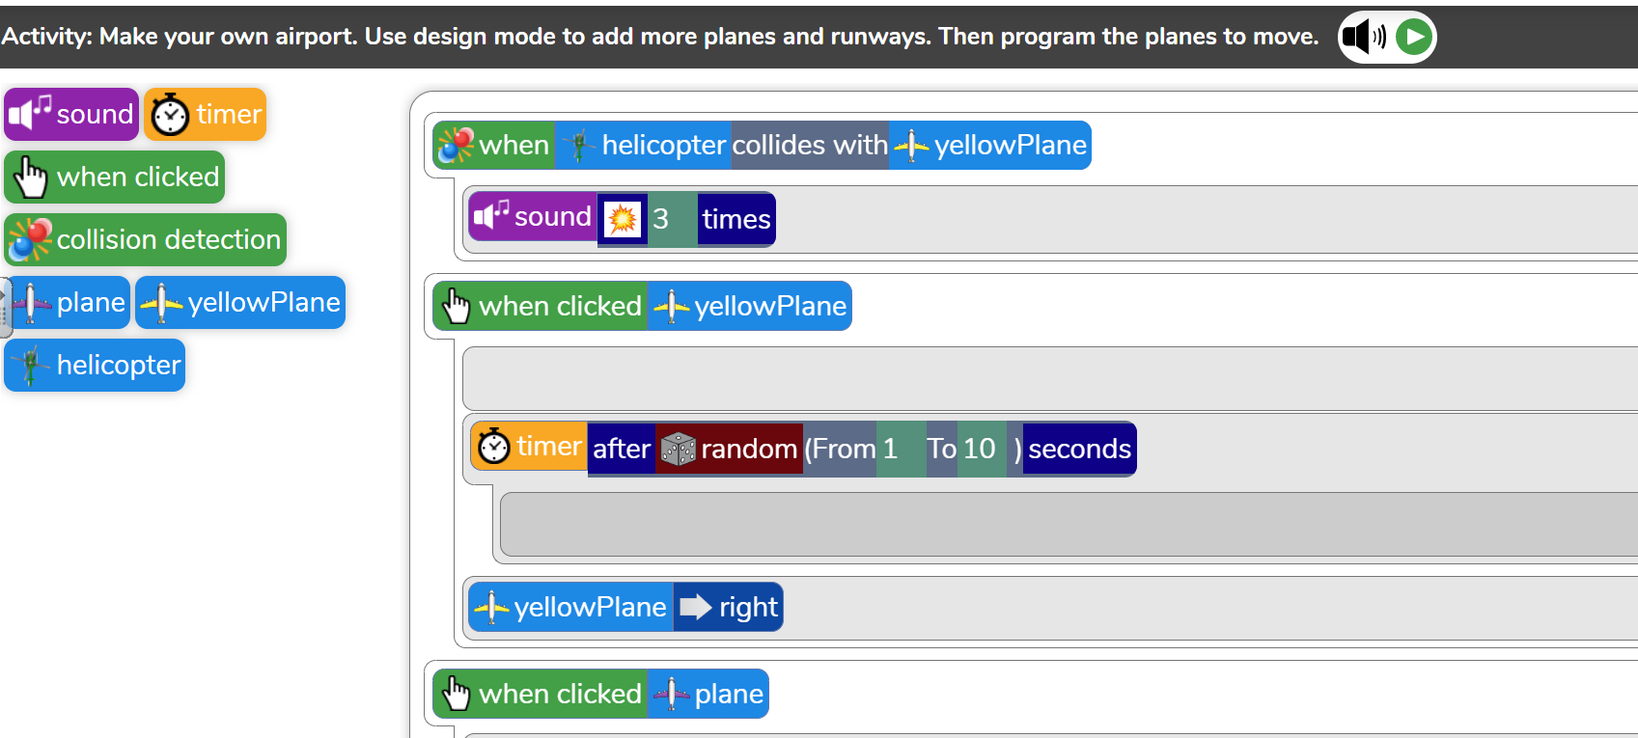
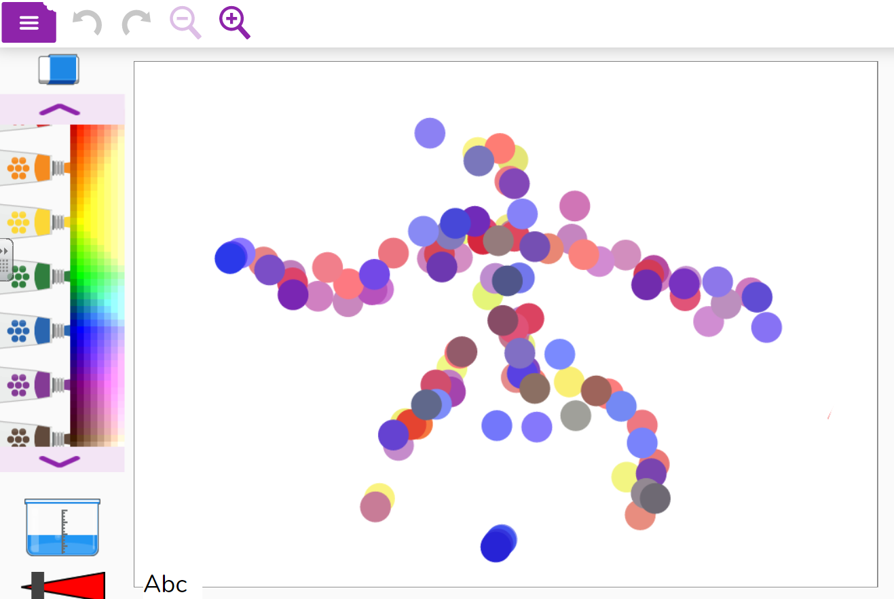
Examples of work

Slide 14




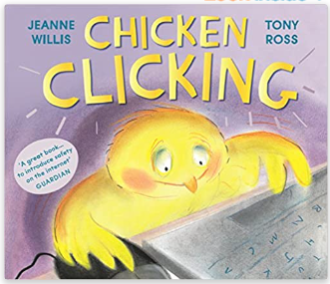
Online safety
Teaching of online Safety is ongoing and weaves in to all aspects of computing e.g. Reminding the children not to share their login details, or searching a trusted website, or identifying a trusted adult.
Year 1 and 2 cover a unit of work focusing solely on ‘Online Safety’ through Purple Mash.
Safer Internet Day – annual event we take part in to celebrate the importance of being safe online.
Books and assemblies

Slide 15
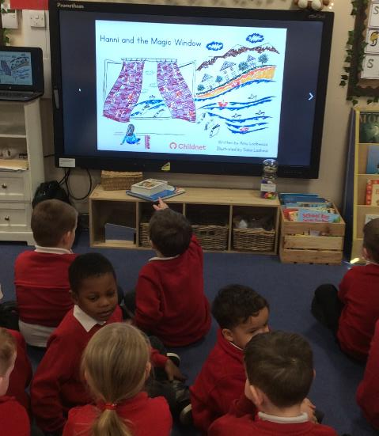
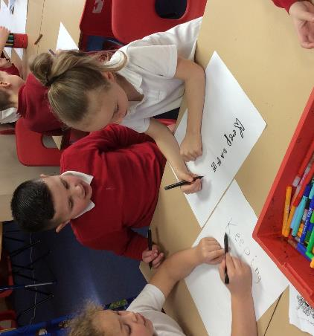
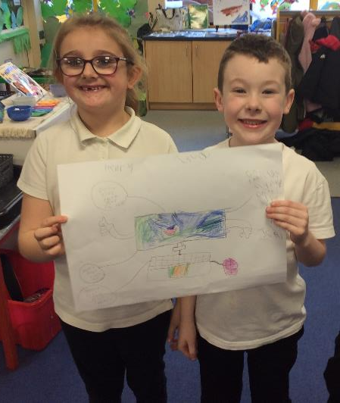
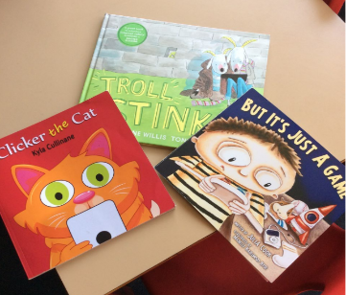
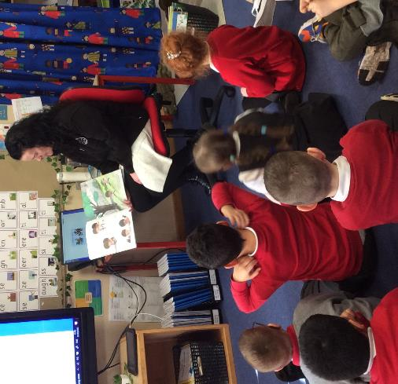
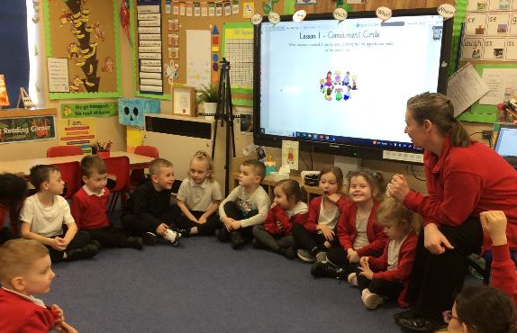
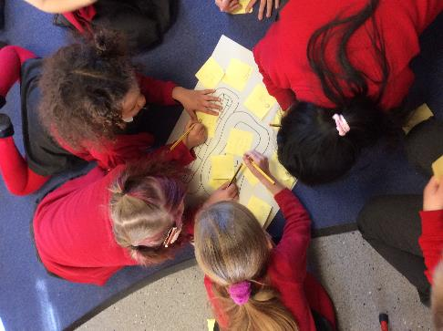
Safer Internet Day

Slide 16

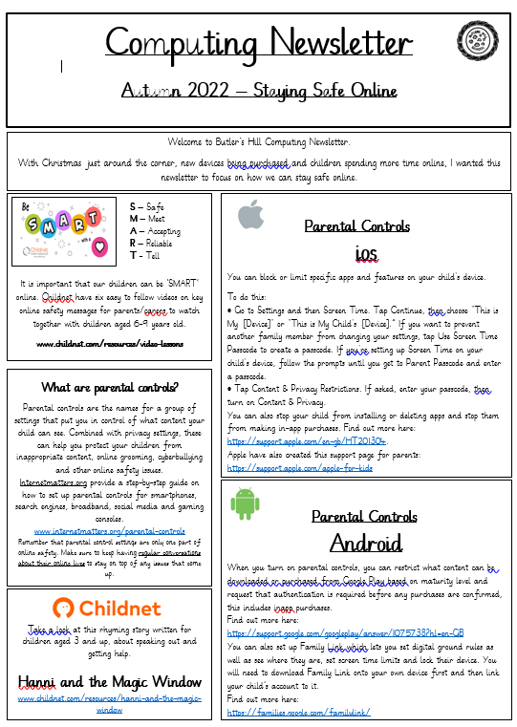
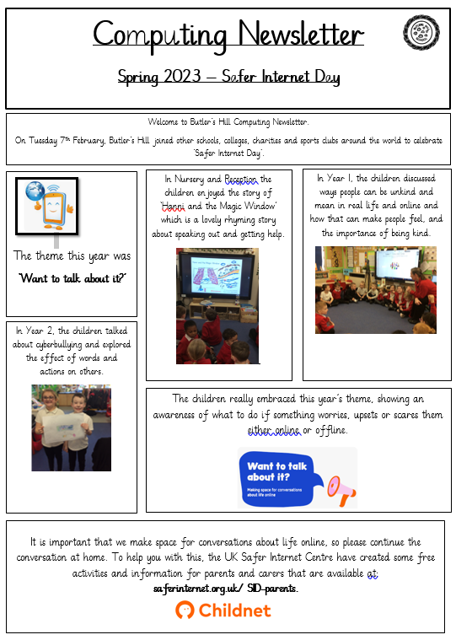
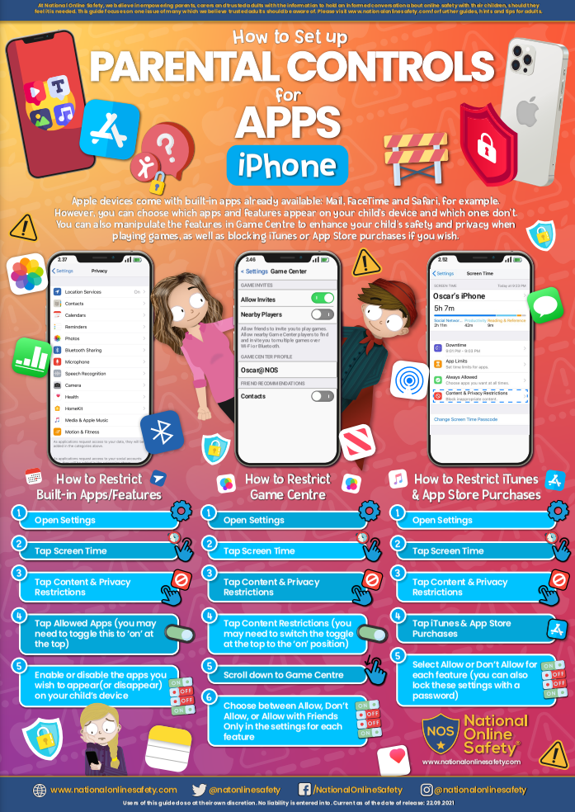
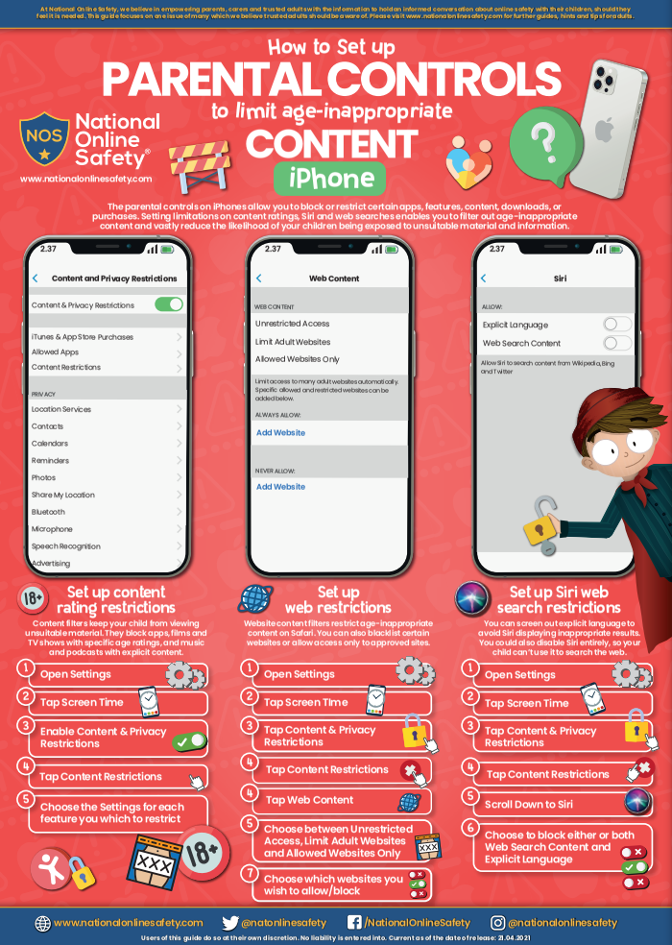
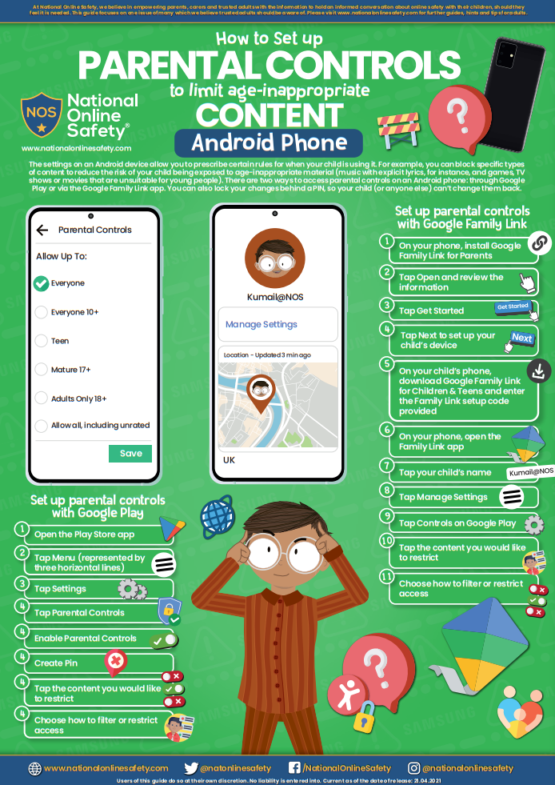
Online safety for parents/carers
#WakeUpWednesdays parent guides on Dojo and website
How to set up parental controls on devices at home video guide
Links to FREE webinars e.g. Natterhub Online Safety and, Eventbrite East Midlands Special Operations Cyber Protect Officers online safety advice for parents webinar
Termly Computing newsletters on Dojo and website

Slide 17
Pupil voice
Passcode and where I live
YR 1
Where I live
YR 1
Password
YR 1
What personal information should only family know about you?
Password and address
YR 2
Login info and password
YR 2
Password, login details and full name
YR 2

Slide 18
Pupil voice
Go tell a grown up
YR 1
Tell mummy and daddy
YR 1
Ask my mum
YR 1
What would you do if something pops up on your device and you do not know what it means?
Click off it
YR 2
Turn it off and tell a trusted adult
YR 2
Turn it off and tell mum
YR 2

Slide 19
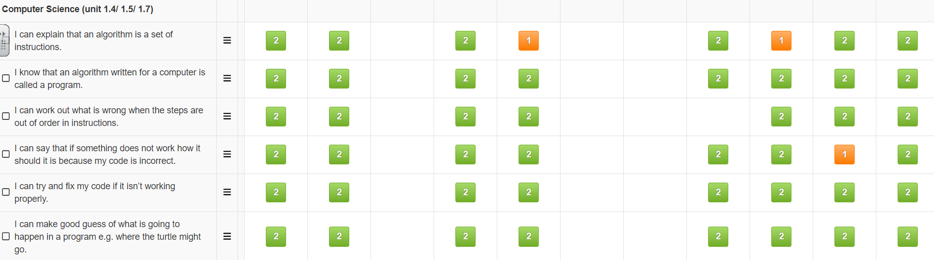

Assessment
Assessment is ongoing in computing
Pupil attainment is tracked on ‘Insight’ linking to the year group objectives
Gaps in learning are highlighted clearly
NEW - At the end of each unit the children will take the Purple Mash unit quiz as a whole class or individually to recap previous learning and support AFL

Slide 20
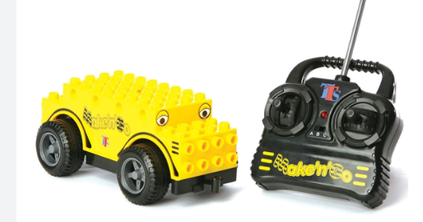
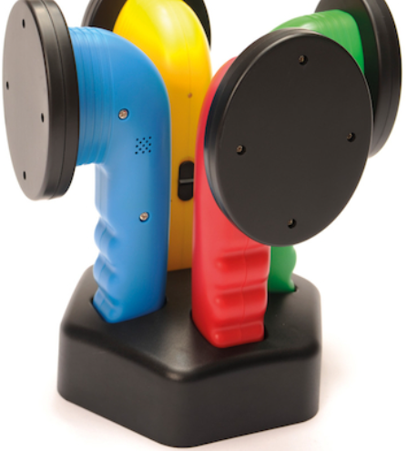
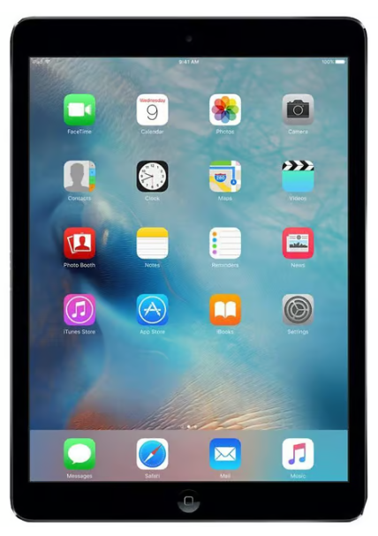
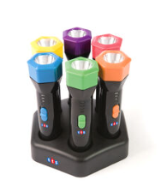
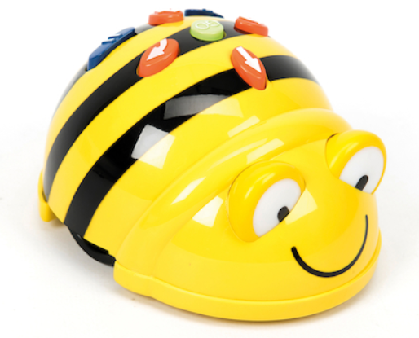
Resources
Purple Mash/ Mini Mash
Chrome Books
iPads
Easi-detectors
Easi-speak microphones
Talking buttons
BeeBots
Make n Go remote control vehicles
Talking postcards
Easi-Torch

Slide 21
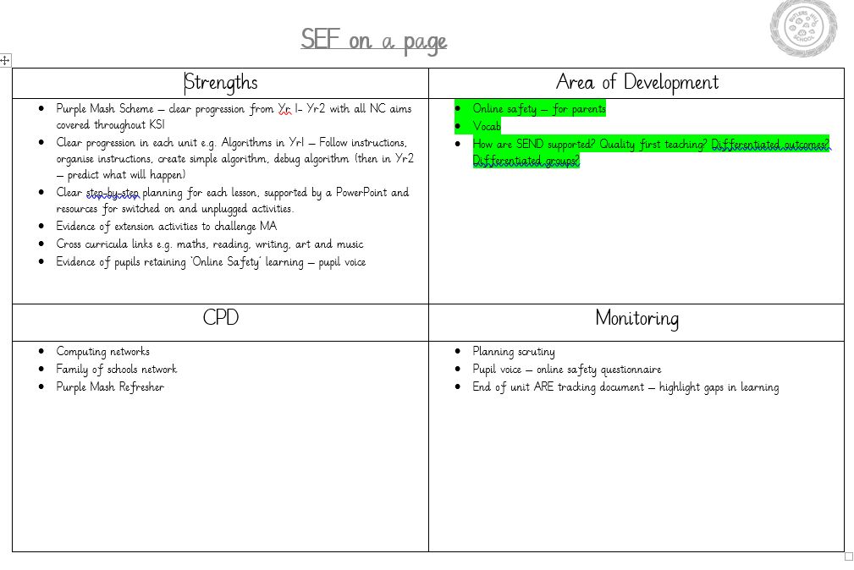

Slide 22

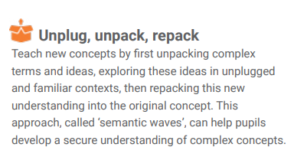
What next for computing?
Example of unplugged activity – Kidbotz (1:09:52)
https://www.youtube.com/watch?v=LH7cNtnV5DY&t=3748s

