Slide 1
Science at Butlers Hill Infants
Miss Carrington 2024

Slide 2
How do we teach Science?
At Butlers hill we teach our Science Curriculum through White Rose Science to ensure we meet the National Curriculum by the End of Key Stage 1.
Why did we choose White Rose Science over other Science Scheme?
We decided as a staff as we already used White Rose for Maths and liked the small steps to introduce new concepts to our children that we would use White Rose Science to help our children to remember more as the children recap prior knowledge throughout the year and use their knowledge in other curriculum areas.
We are the foundations for further development in Key Stage 2 at Broomhill they use cornerstones to teach their Science Curriculum.
Notes:
This is the question that your experiment answers

Slide 3
In EYFS, We explore, model, scaffold and develop children’s ideas and thinking through their play and interests. We also have exploration station/investigation stations in our continuous provision. We develop and teach new vocabulary in play and during inputs/carpet times. We evidence this in our floor books under the Natural World and link where we can to our topics. In F2 we have introduced White Rose Science which also links with our Maths learning and themes.
In Key Stage 1, we use flashback 4 at the start of our Science lesson to recall prior knowledge/vocabulary taught within White Rose Science, we use the end of unit assessment in the term after it has been taught to ensure children are remembering the knowledge taught and support children who need it.

Slide 4
SEN and Science
In the Rainbow room the children explore Science through sensory activities at their level and use appropriate vocabulary, they also use the EYFS curriculum in their play or modelled.
Children are given an adapted worksheet at their level or show their knowledge through investigations. The children are able to draw their ideas or findings, label or explaining to an adult and they scribe. It has become more practical and less cutting and sticking activity to assess their knowledge and use of vocabulary. All children are included in whole class where possible, use of thumbs up thumbs down or talk partners to share ideas or support each other.
In the EPU children are taught Science through their year group. They also use the outdoor classroom area for Forest Schools which is currently being developed.

Slide 5
End points for EYFS and KeyStage 1
End Goals Science
EYFS
Our aim in teaching Science is to foster pupils’ curiosity about the world around them. By the end of this phase, pupils should be able to use their senses to investigate a range of materials and should be starting to become familiar with the concept of natural and man-made materials and changes in matter. Pupils should be able to talk in simple terms about how plants and animals change over the course of their life cycles and observe the growth of a plant from seed to full development. Pupils should recognise that humans and animals require a suitable place to live and need food and water to survive. By the end of this phase, they should also be aware of seasonal changes and be able to have conversations about what they see, hear and feel outdoors. Pupils should be able to start making comparisons between two or more things e.g. objects, animals, recognising similarities and differences between them.
KS1
Our aim in teaching science in is to embed and build on learning from EYFS by beginning to develop their ability to work more scientifically. By the end of this phase, pupils should be able to write basic methods for experiments and use some simple equipment to observe and record their findings. They should also be able to make predictions, with reasons for their ideas, before proceeding with an experiment. Pupils should be able to draw on some of their mathematical skills to create charts from data collection and use this data to draw conclusions. Pupils should be able to use a wider range of scientific vocabulary in both their class discussions and written work. We believe that learning in science develops through the experience and development of scientific concepts in incremental steps in each phase. They should also have a secure knowledge of what animals and plants need to survive and be able to classify things that are alive and those that are not. Pupils should also be able to explain in more detail the process of growing plants from seeds and bulbs, using a wider scientific vocabulary. When working with materials, pupils should be able to distinguish the difference between an object and material/s it is made from. They should also be able to conduct some simple experiments on the suitability of certain materials for different uses.

Slide 6
Data – 2023/2024
In Key Stage 1 – Science data shows 88% of our children left at the expected level or above. The National Level is 82% therefore using White Rose has had an impact on our children’s Science Knowledge.
In EYFS - 77% of children moved into Key Stage 1 at ARE for the Natural World. This year we have started White Rose Science in F2 as they have bought out the scheme and the impact it has had in Key Stage 1.

Slide 7
Co-ordinator CPD
Purchased Science book from Kirstine Beeley for Ideas in EYFS for continuous provision.
Qualified as an Assistant Forest School Leader and working with staff in EPU to give them ideas and books to use to support them.
White Rose Science webinars in November to ensure I am planning correctly and using the scheme to its best.

Slide 8
Science in Butlers Hill
The 3C’s (aims) We are Caring We are Creative We are Confident The 3R’s (Values) We are Respectful We are Responsible We are Resilient | Enrichment opportunities White post farm (Nursery) Broomhill farm (Nursery) Jungle Jo (Foundation 2) The Old Barn (Foundation 2) Yorkshire wildlife park (Y1) Sherwood Pines (Y1) Brooke Farm (year 2) Zoo Lab (Year 2) Great Fire of London Science Tots afterschool club (F2-Y2) | Assessment/sticky knowledge Year 1 and Year 2 – end of each Science unit to show knowledge/progression. Mini pre/post test Assessment grid to know % of children that are meeting ARE – subject leader to identify any areas where a large % of children have gaps.
Concepts Life Matter Habitation Being Scientific | Local community links Titchfield Park | Cross Curricular Links Art (observational drawings) History Topics (Great Fire/WW1) Geography (Rainforests/Dinosaurs/Africa/Icy Issues Maths – data handling, measurements PSHE
Notes:
Summarize your research in three to five points.

Slide 9
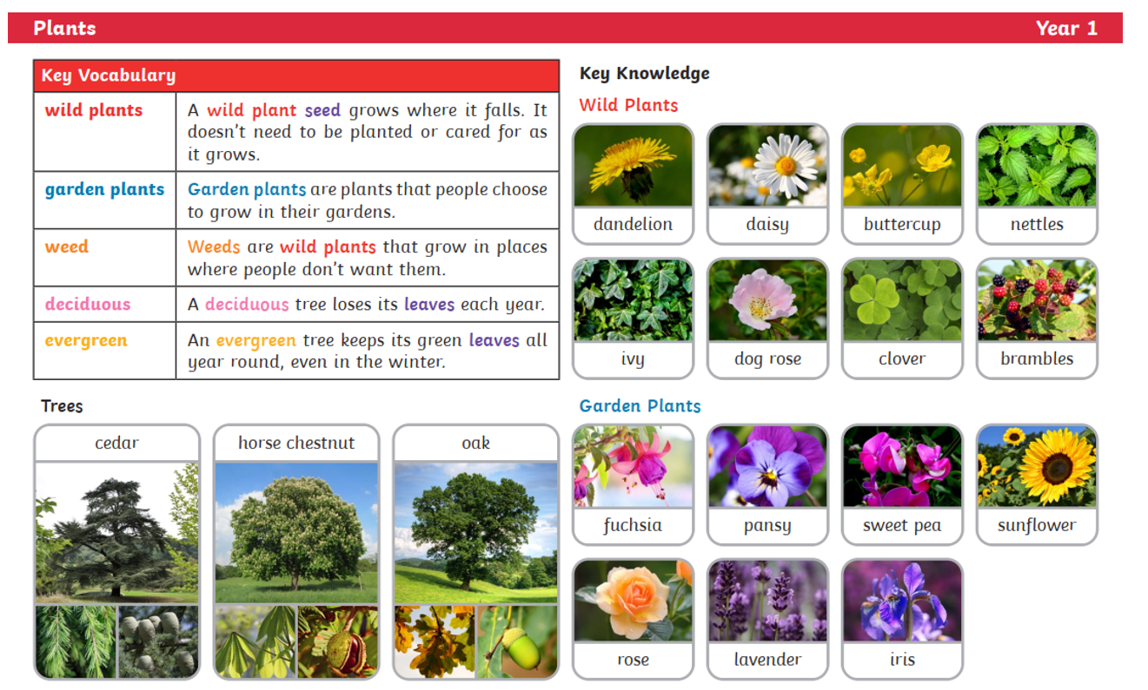
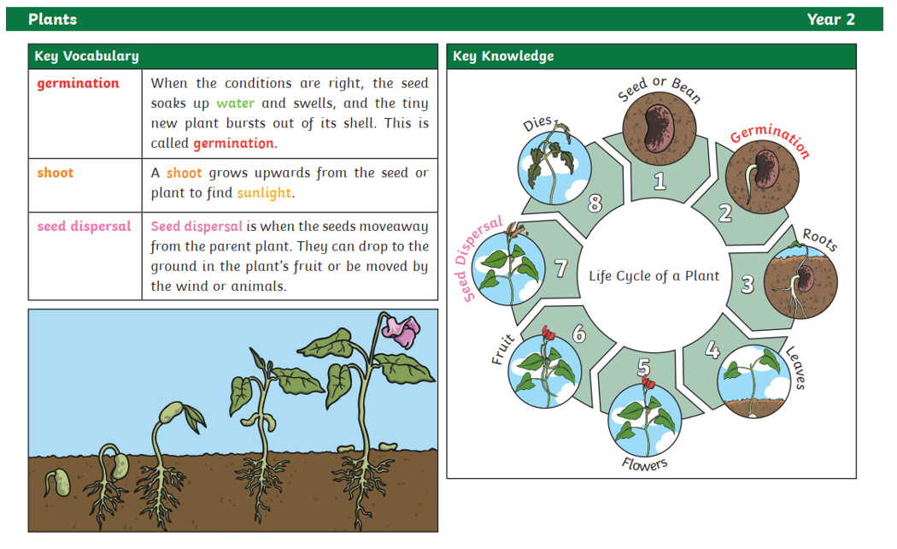
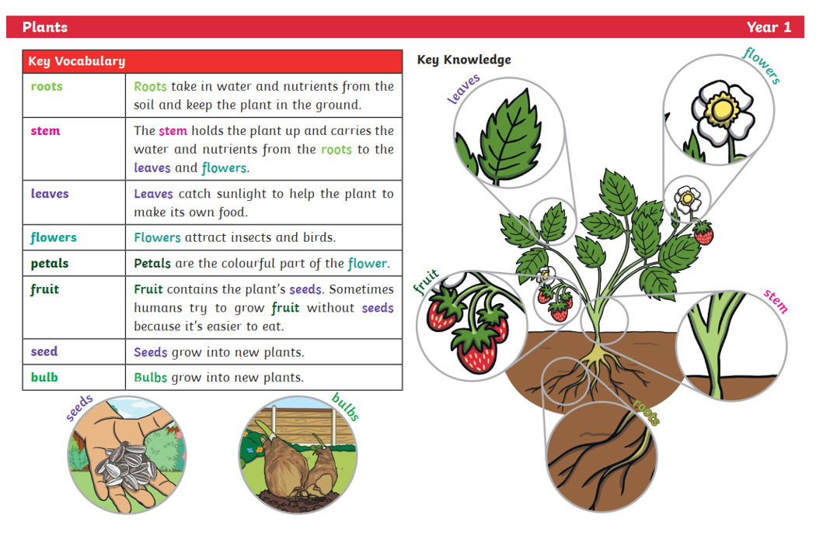
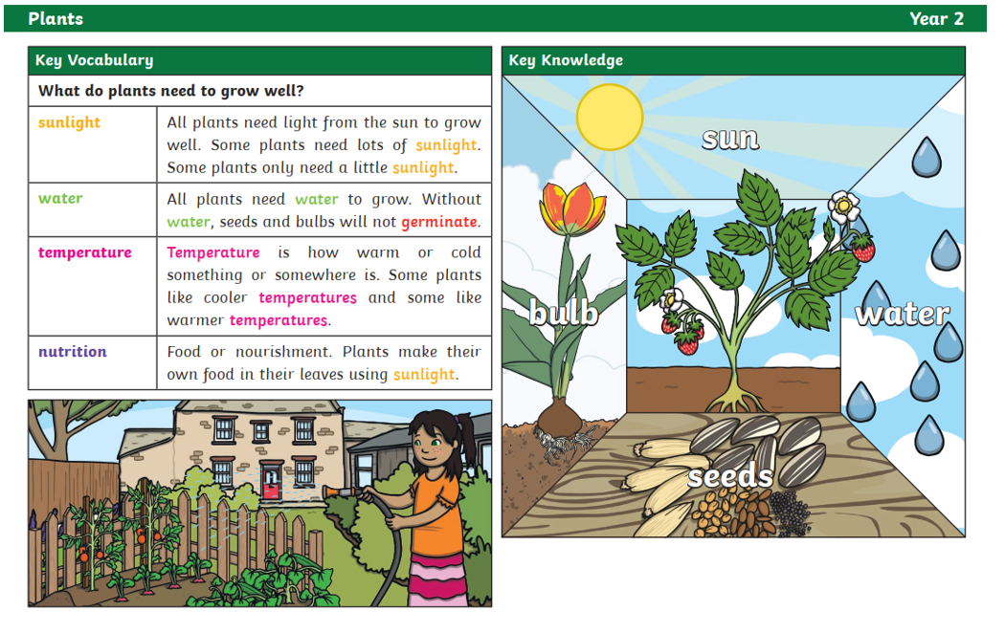
Life – Plants

Slide 10
Long Term Plan EYFS
Understanding of the World | Autumn 1 | Autumn 2 | Spring 1 | Spring 2 | Summer 1 | Summer 2
Nursery | * Exploring materials | * Exploring lives of themselves and others, inc what they see (cultural) | * Exploring lives of themselves and others - occupations | * Explore materials & changes & forces | * Exploring Life cycles & caring | * Exploring Countries
F2 | Focus on Autumn/Winter garden area in F2 playground & forest school area Materials linked to 3 little pigs (all about me families | Focus on Autumn garden area in F2 playground & forest school area changing state of matter (gingerbread man)/ Ice or snow melting | Focus on winter garden area in F2 and Forest school Area Changing state of Matter ice/snow melting | Focus Spring, growing vegetables, trip to a working farm to identify and pick (old Barn Farm) Changing state of matter – cooking vegetables/making Easter nests | Focus Summer, common British minibeasts and their habitats, lifecycle of a ladybird Jungle Jo Sunflower challenge? | Focus on Summer seaside day
I have changed knowledge and understanding/welly day for EYFS to ensure we are the building blocks for Key Stage 1 eg. Autumn 1 with all about me we talked about materials and linked to three little pigs. Autumn 2 we created gingerbread men to show changes in states of matter. Spring 1 – we talked about deciduous and evergreen trees around school ready for year 1. Spring 2 – making Easter nests (changes of state) and growing seeds/bulbs/vegetables to notice changes

Slide 11
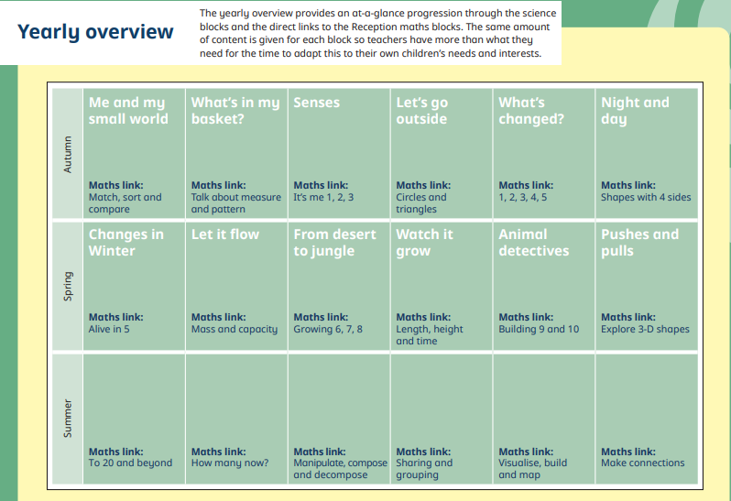
F2 – White Rose Science

Slide 12
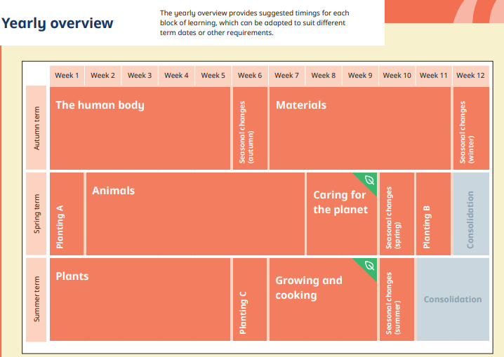
Year 1

Slide 13
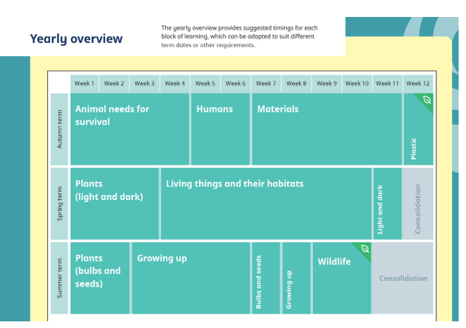
Year 2

Slide 14
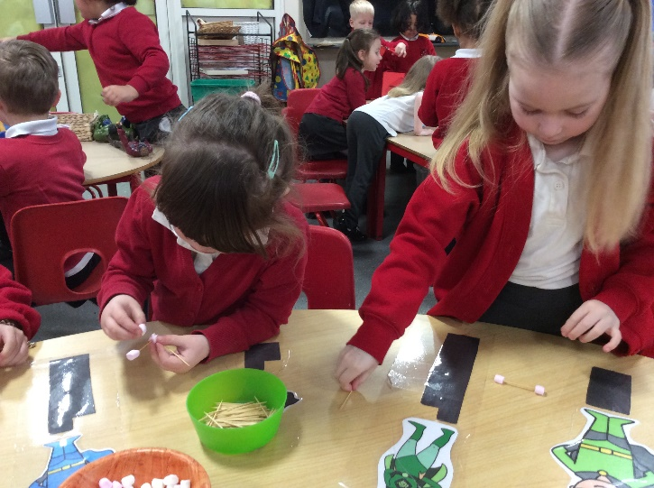
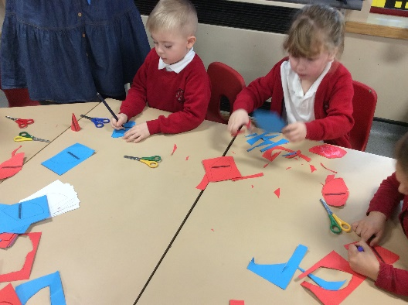
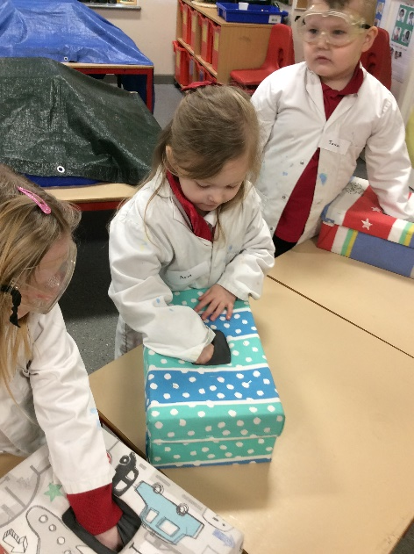
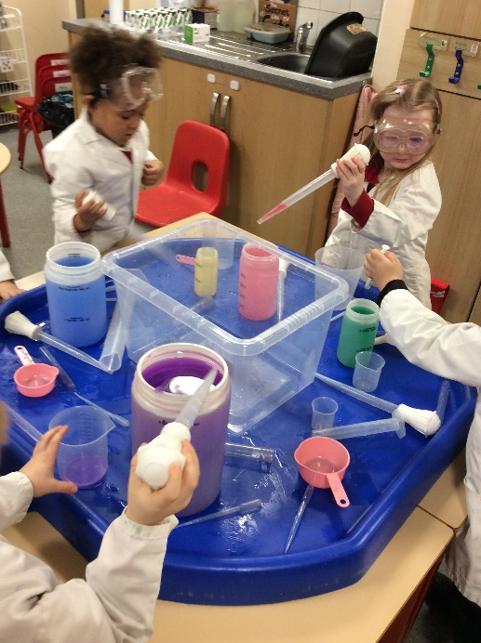
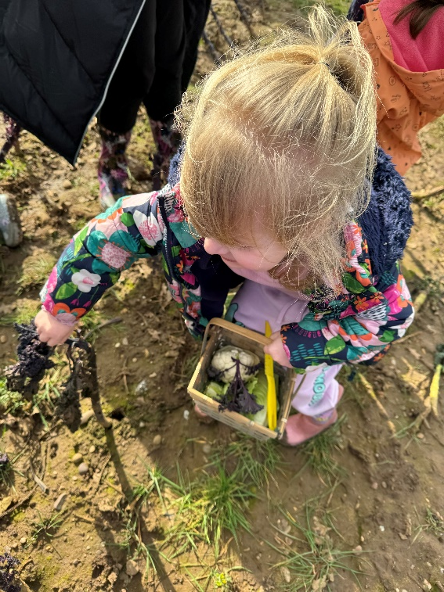
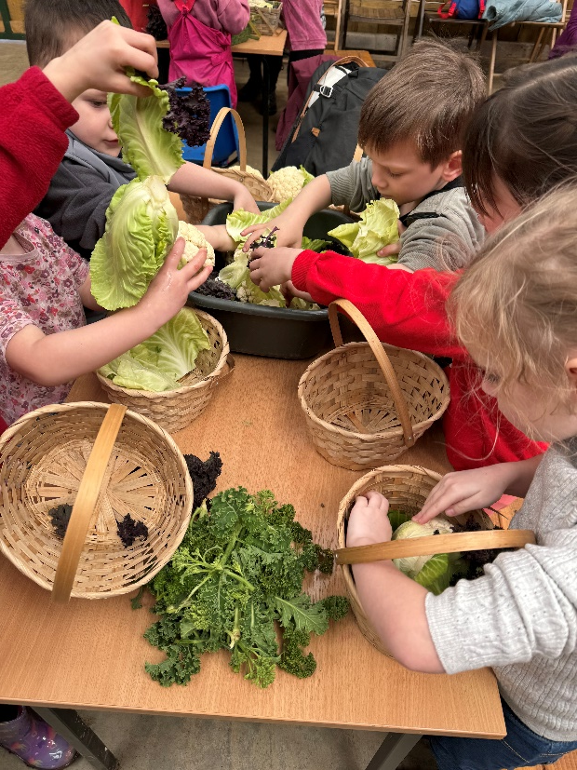
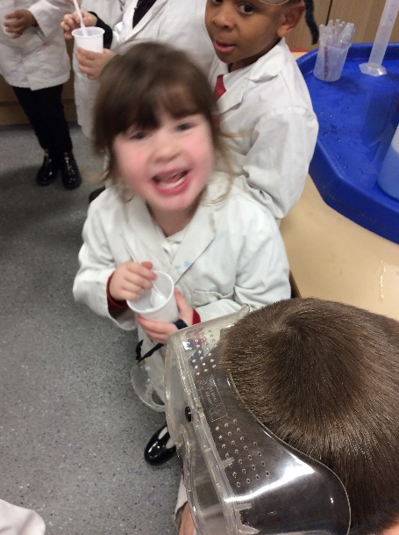
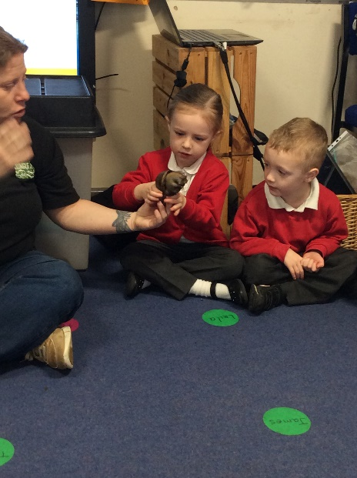
Science In Action - EYFS

Slide 15
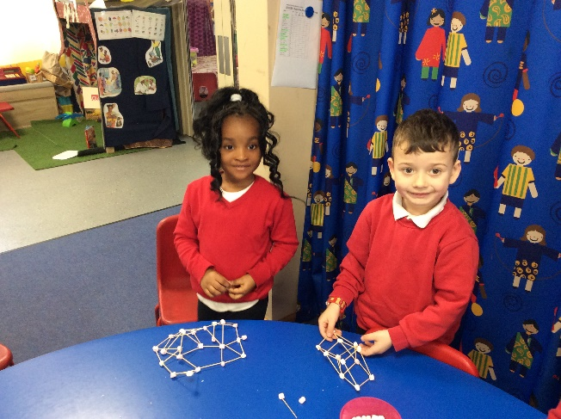
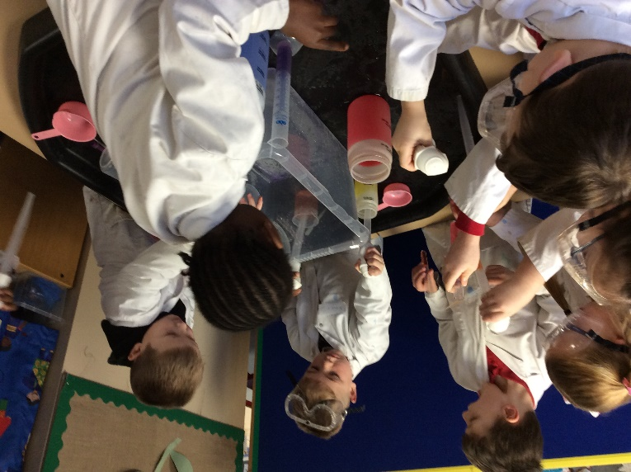
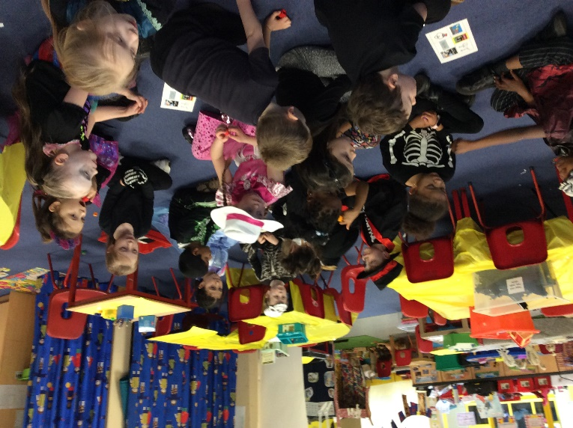
Science in Action – Year 1

Slide 16
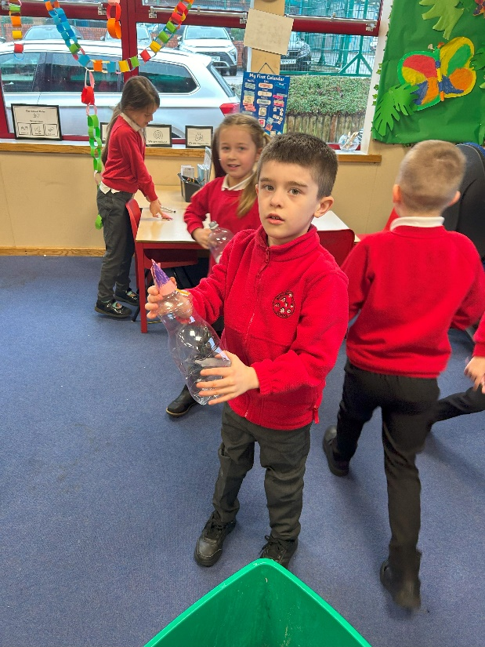
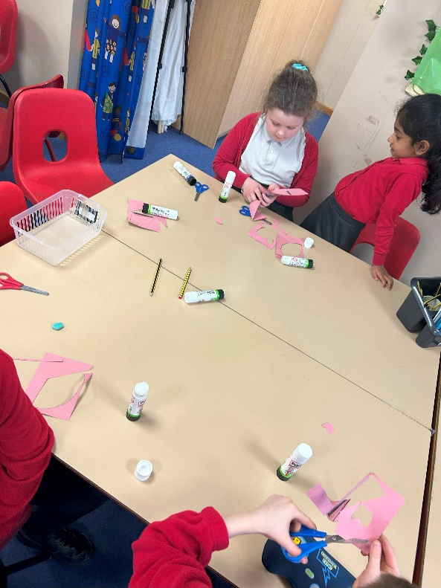
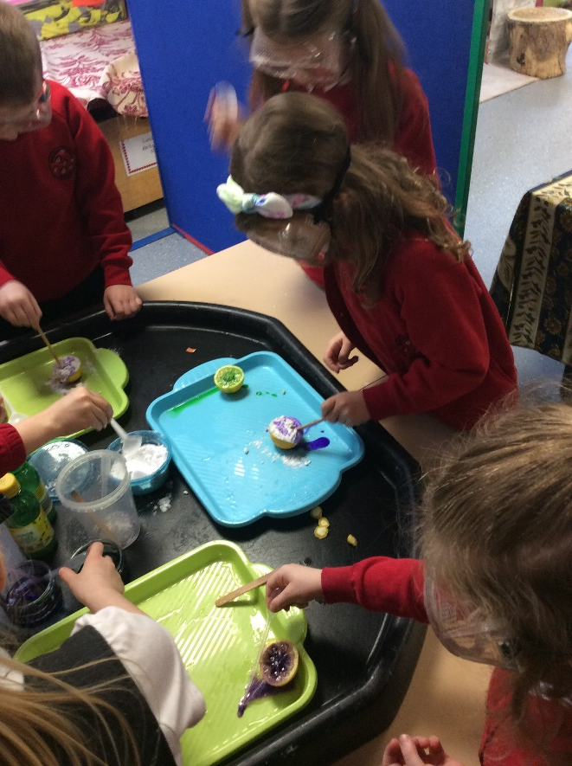
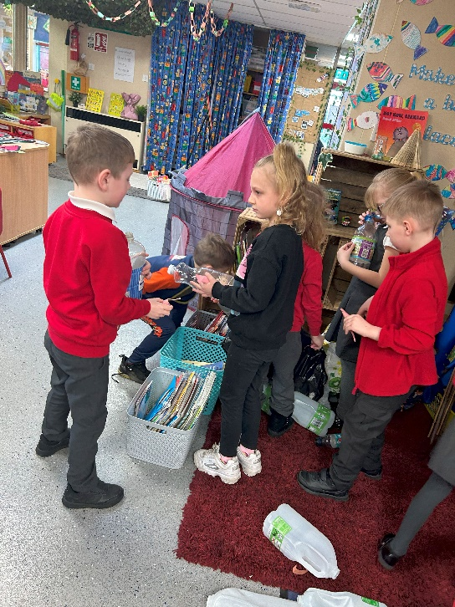
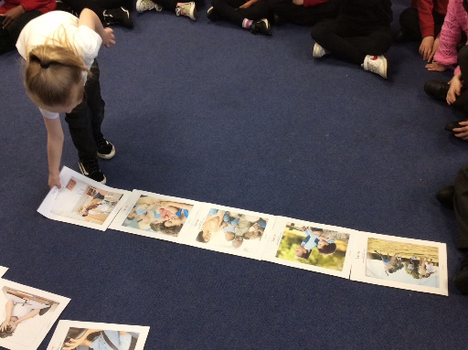
Science in Action - Year 2

Slide 17
What next
Continue Working with Rainbow room/EPU to develop Science Ideas
Looking at doing an After School Club e.g. crest award or forest school club.
Developing White Rose into EYFS curriculum
Plan Science Week for March 2025

