Slide 1

History at Butler’s Hill
February 2023 – INSET
Louise Wallis – History Subject Lead

Slide 2
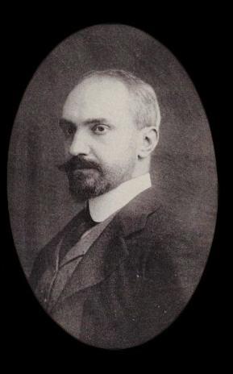
“Those who cannot remember the past are condemned to repeat it.” – George Santayana, The Life of Reason, 1905.

Slide 3
What do we have to study?
As we are an infant school, we have to follow the ‘Statutory Framework for the Early Years’ (2020) in Nursery and F2, and the National Curriculum in Key Stage One Programme of Study (2013).
In the Statutory Framework, under the umbrella of ‘Understanding the World’, we can find statements of intent linked to History teaching in the EYFS, although it is not a discrete subject taught.

Slide 4
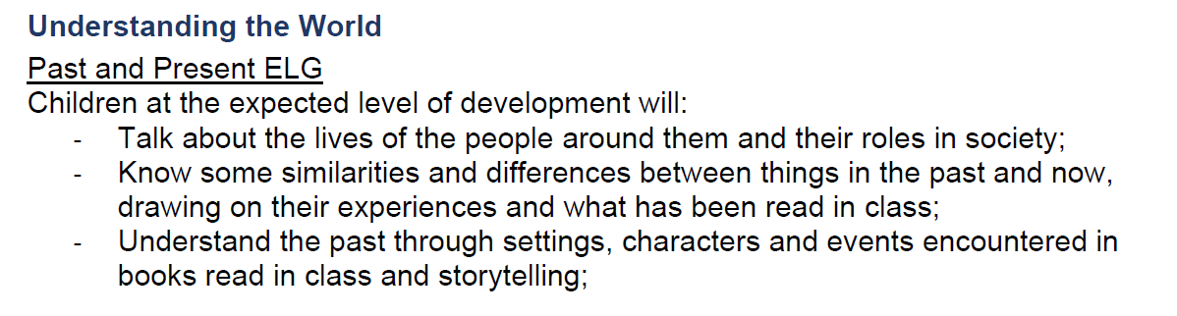
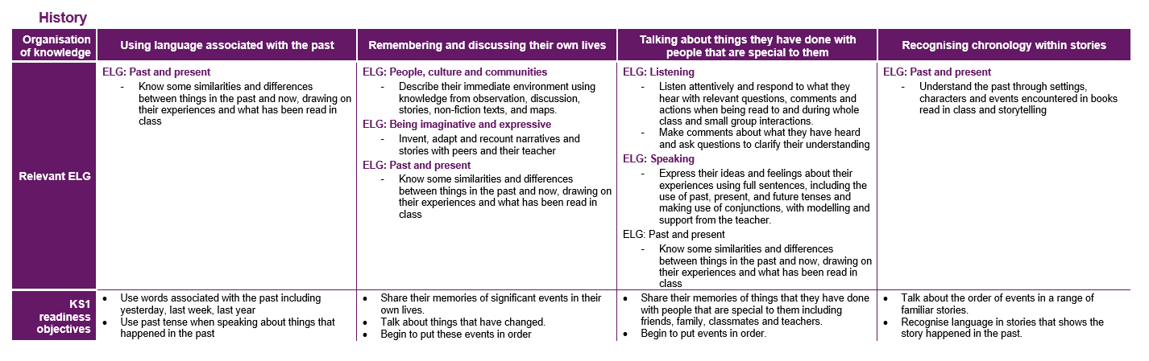

Slide 5
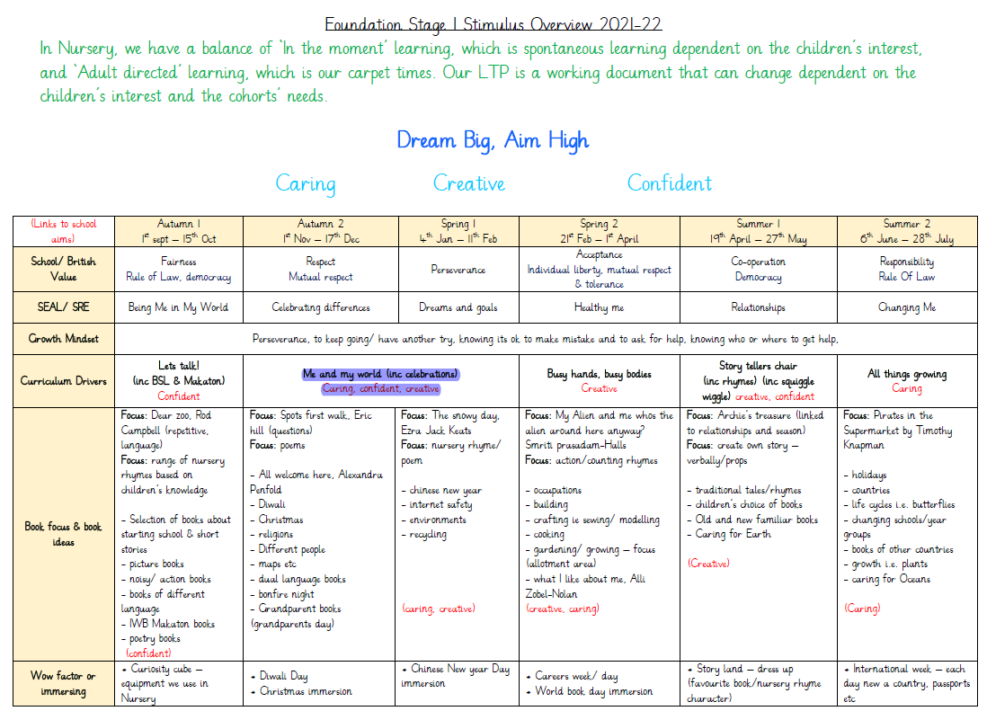

Slide 6
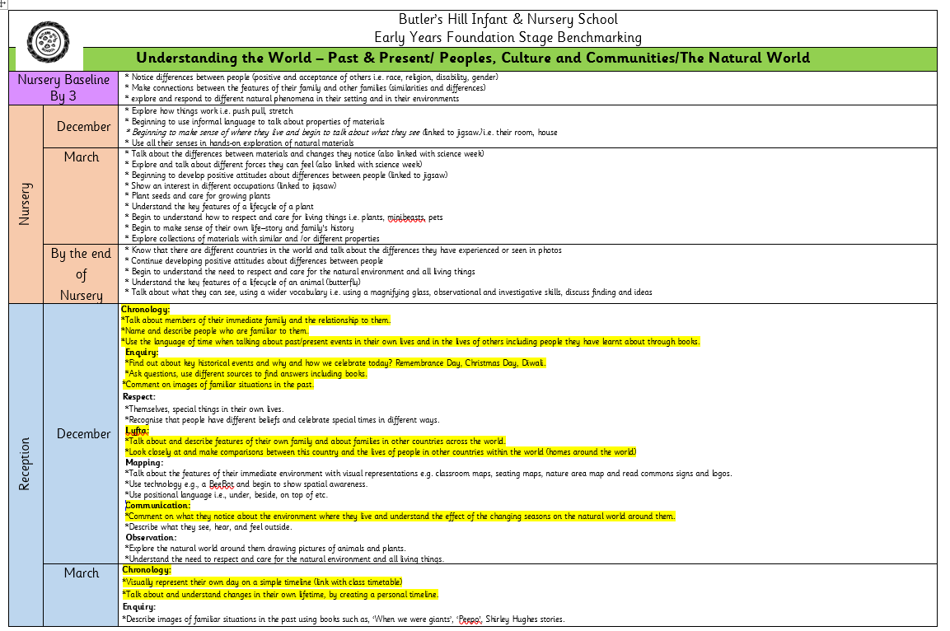

Slide 7
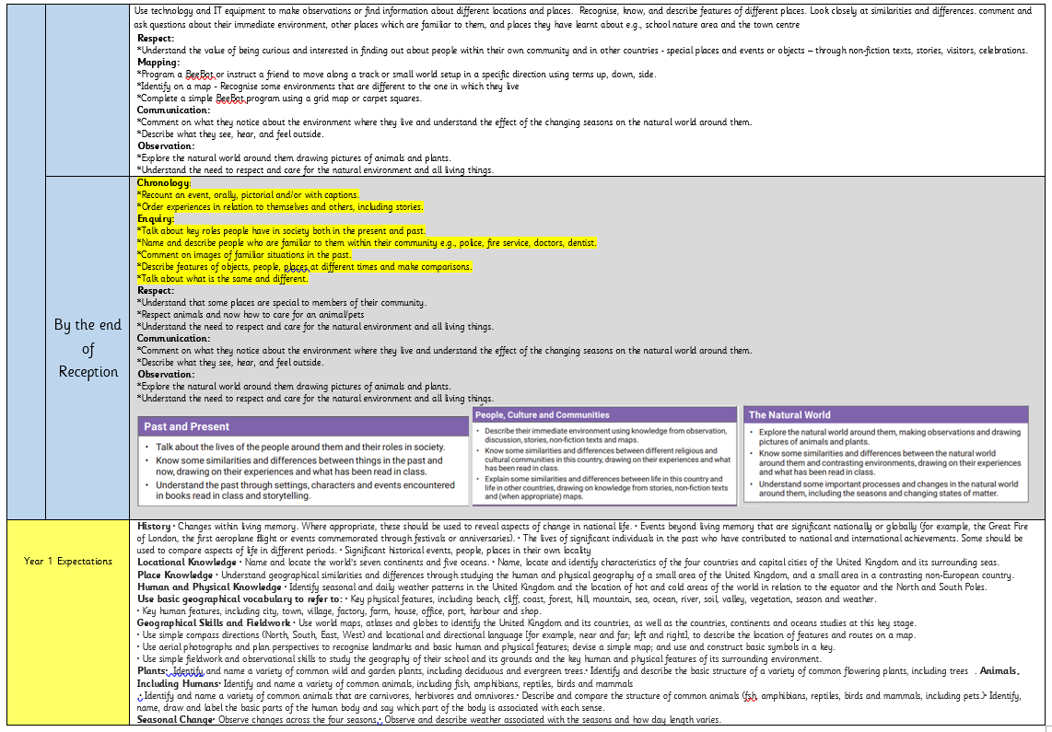

Slide 8
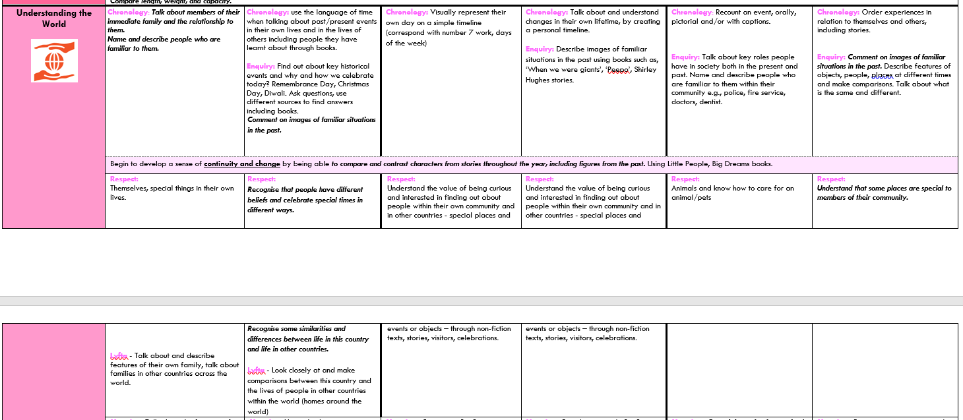

Slide 9
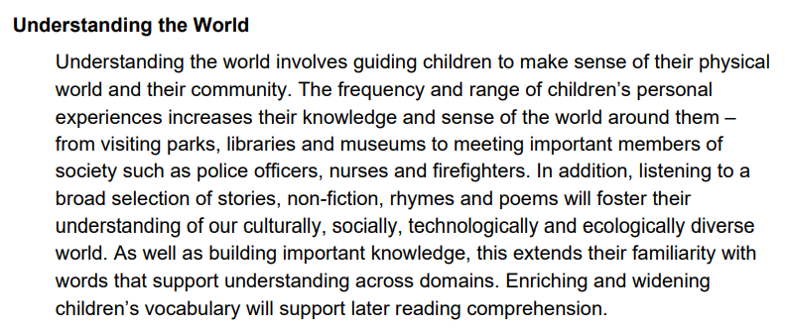

Slide 10
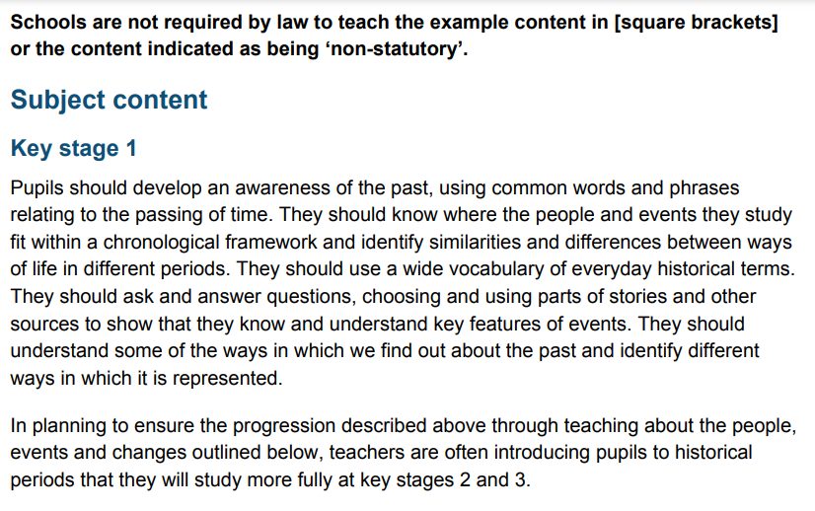

Slide 11
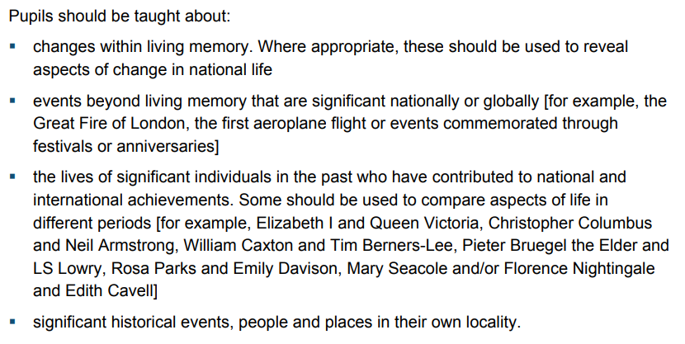

Slide 12

Chronological Understanding
This is one of our 3 key concepts at Butler’s Hill, alongside Knowledge and Understanding and Historical Enquiry.
Pupil Voice conducted in Nov 2022 found that Year 1 and Year 2 children were struggling to understand the concept of chronology.
To try and improve this, we have implemented several things. One is the use of an action (thumbs pointing backwards over shoulder) to remind children that History is ‘in the past’.

Slide 13
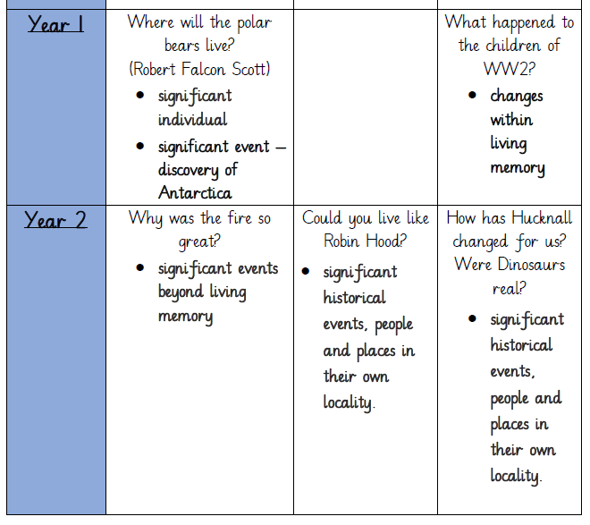
Our topics studied are structured chronologically in time:
1912
1939-45
1666
Medieval/Middle Ages
<- Prehistoric times

Slide 14
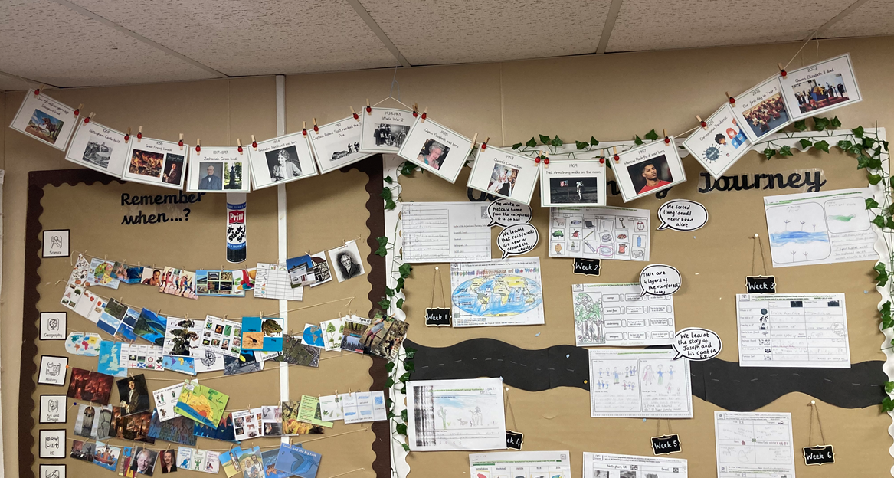
Timelines
Timelines are displayed in all classes. In Key Stage One, each one has the key events deemed important in British History, alongside those relevant to the topics taught in that year group.
Pupil Voice conducted in February 2023 shows that children now have better understanding of when historical events happened in relation to others e.g. before/after.

Slide 15
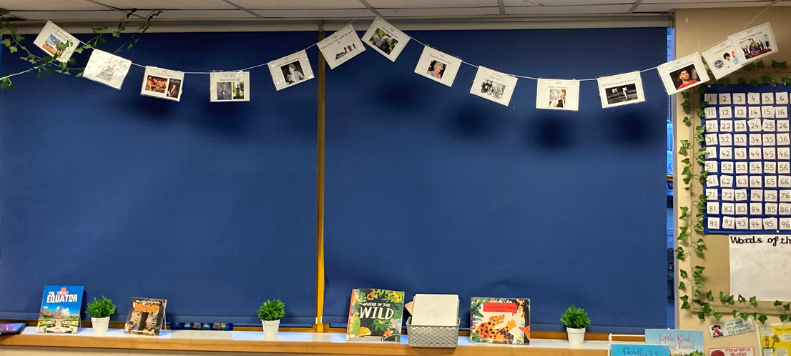

Slide 16
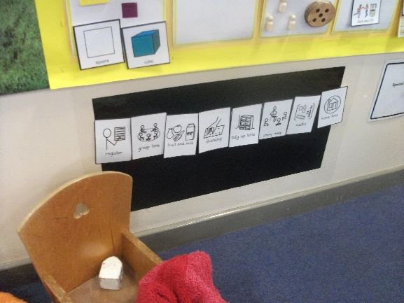
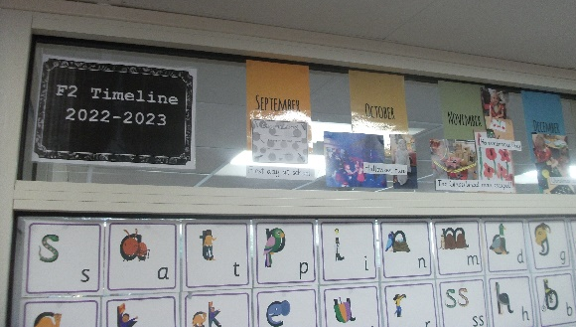
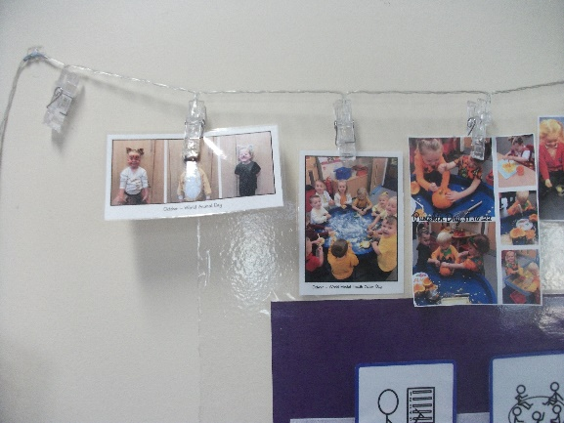
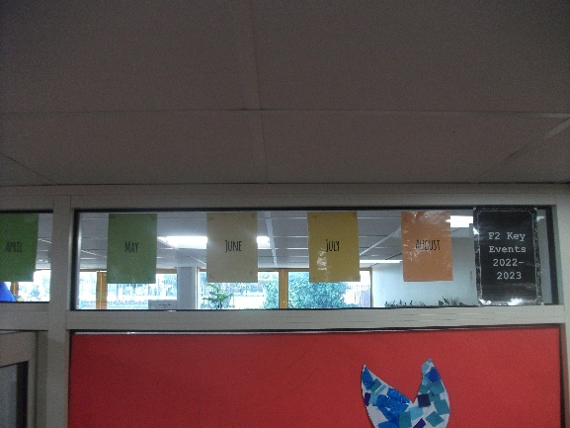
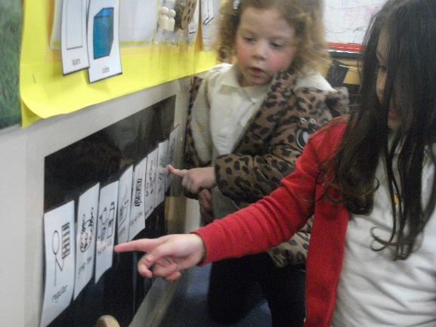
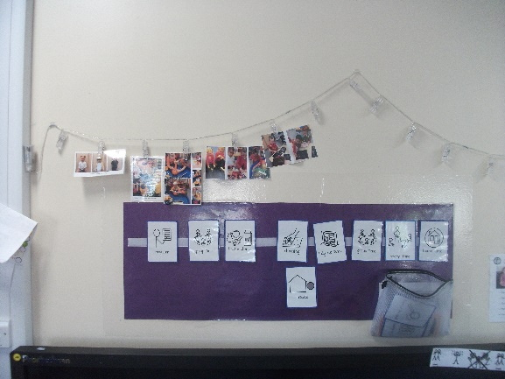
Timelines
In EYFS, there are daily timelines which show the order of events during the day. There are also timelines which are built up throughout the year with key events/special days the children take part in.
These are the building blocks for children developing a sense of chronology in Key Stage One.

Slide 17
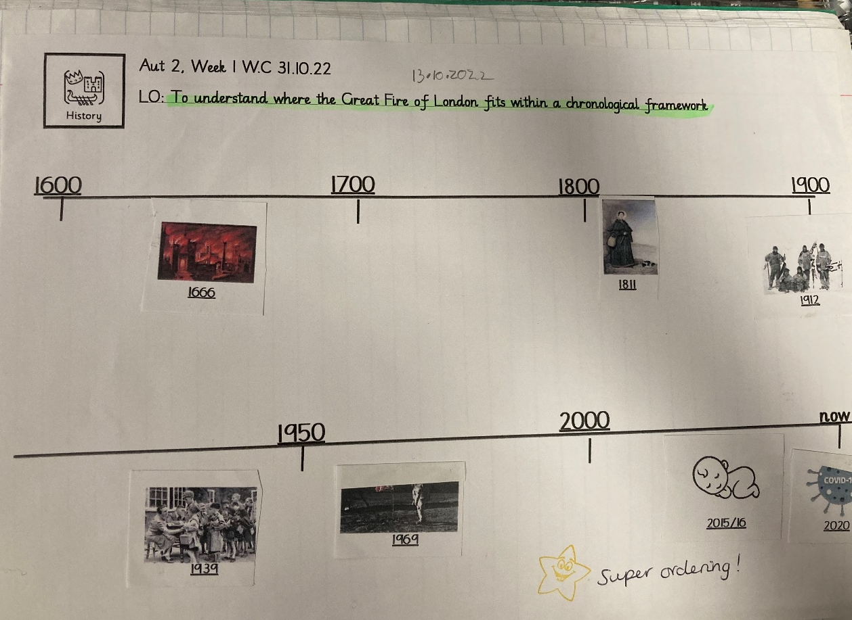
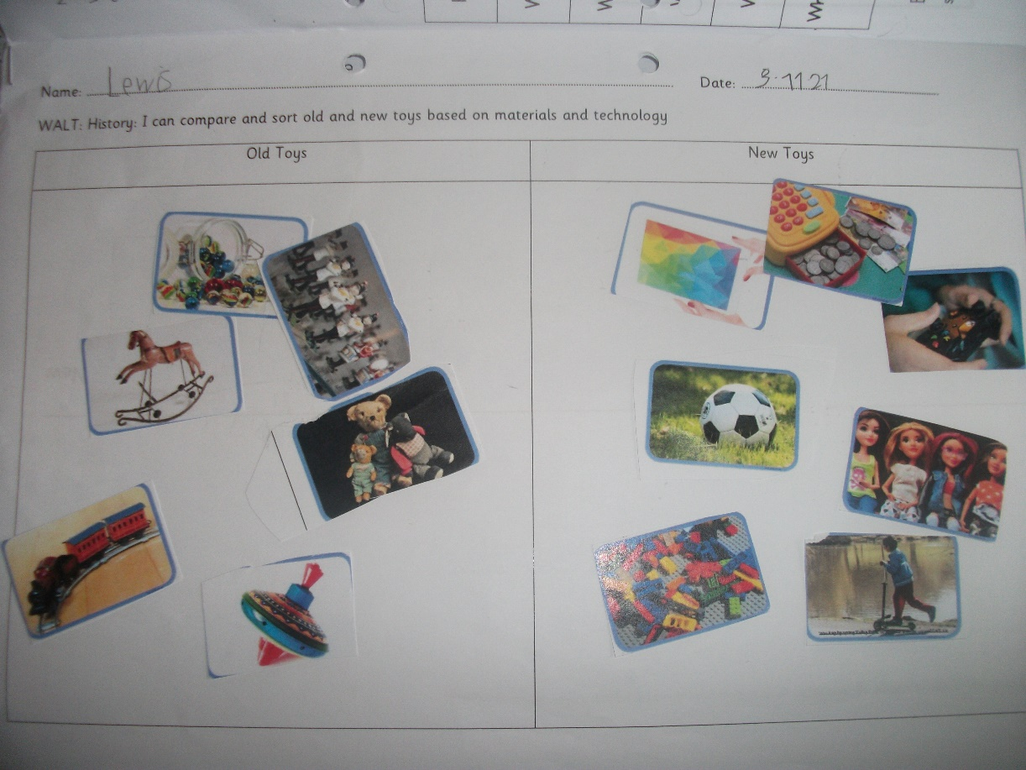
Timelines
Every Year 2 new topic begins with a lesson on timelines, so that children have the opportunity to grasp where the event they will be studying fits into a chronological framework. In Year 1 Autumn 1, children sorted Old and New Toys, as they had not yet been introduced to the concept of timelines.
Year 2
Year 1

Slide 18
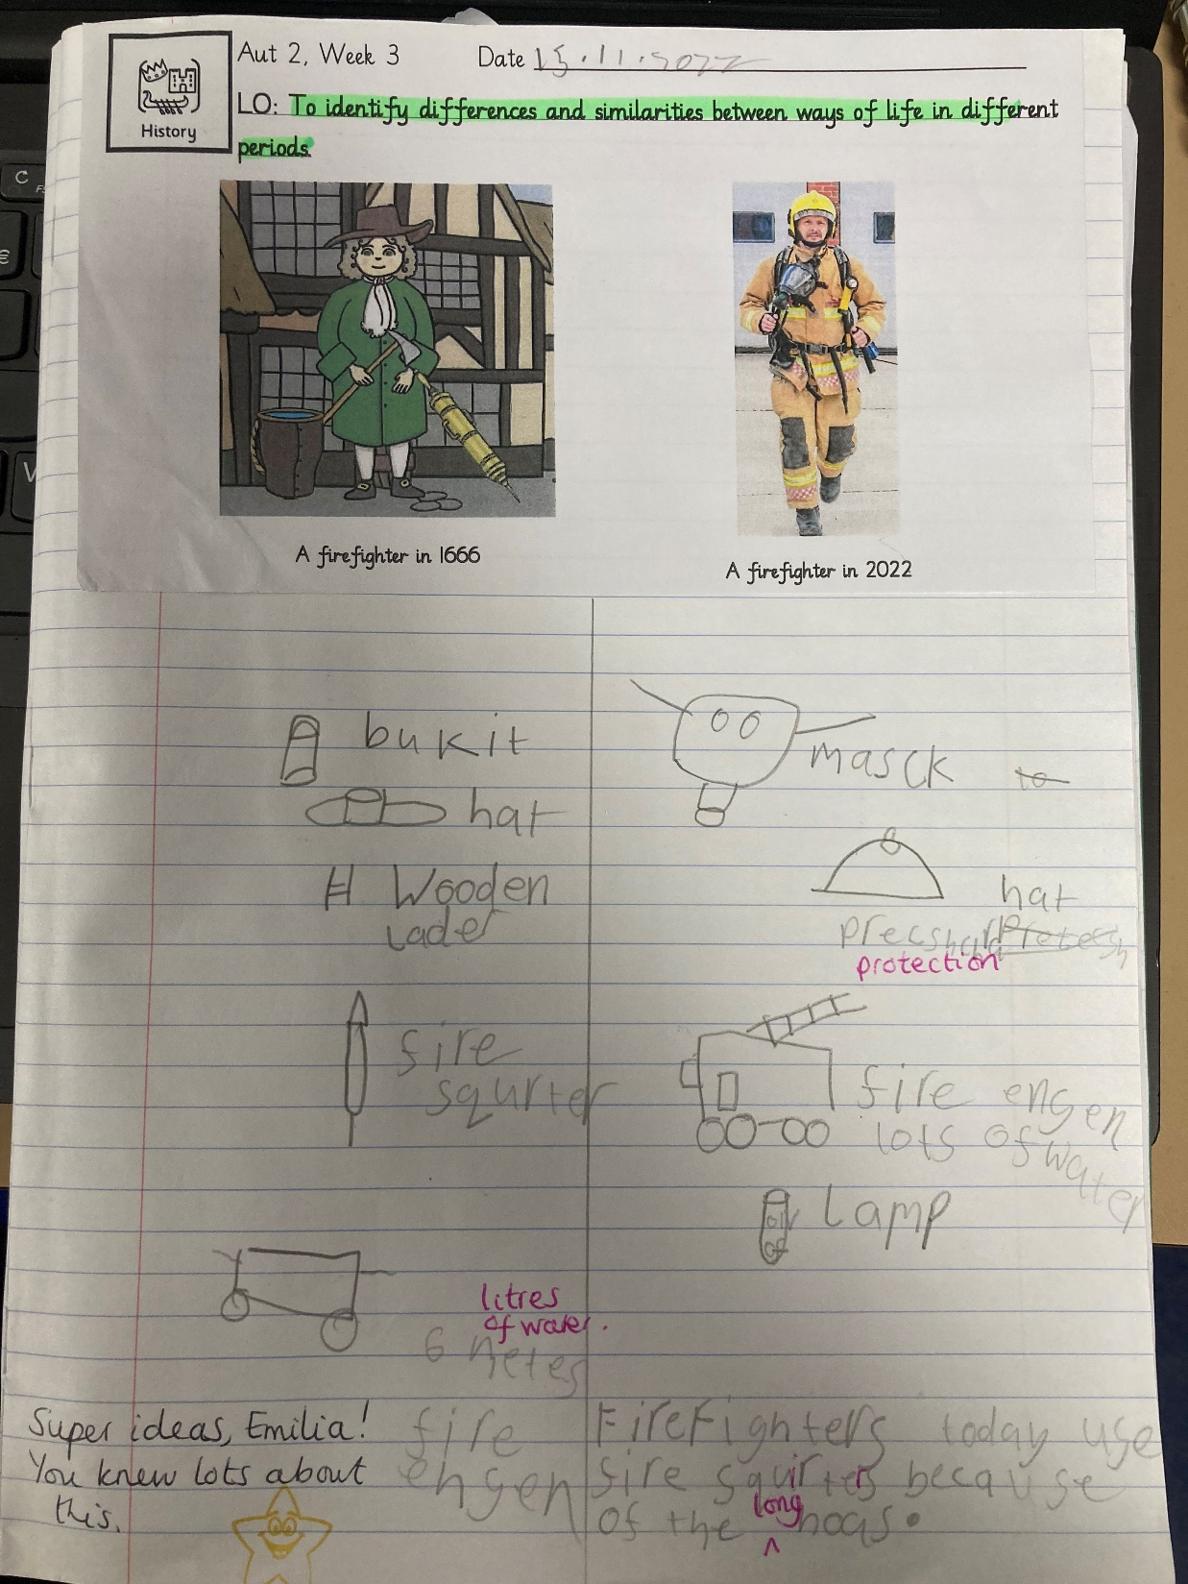
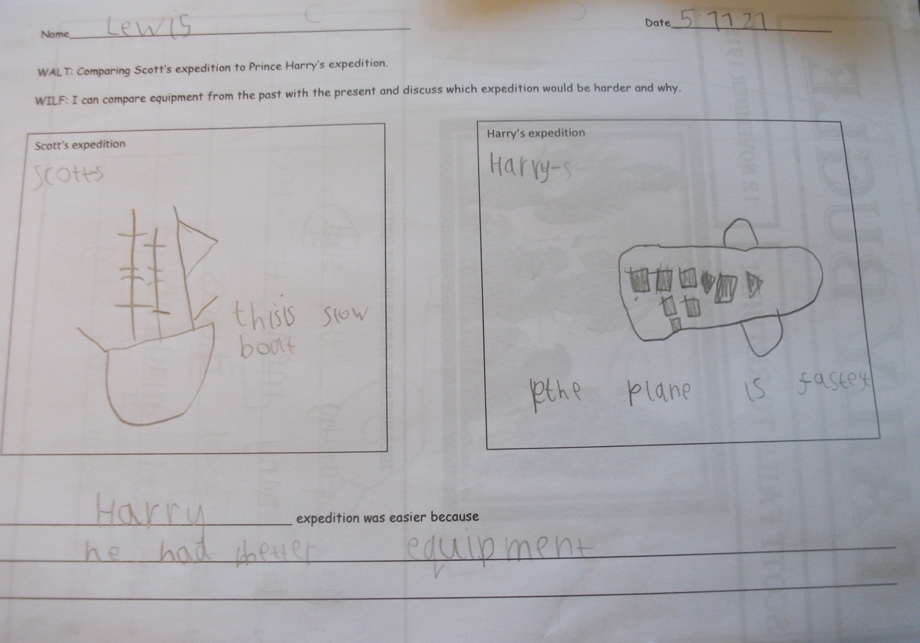
Identifying similarities and differences in different periods
Year 2
Year 1

Slide 19
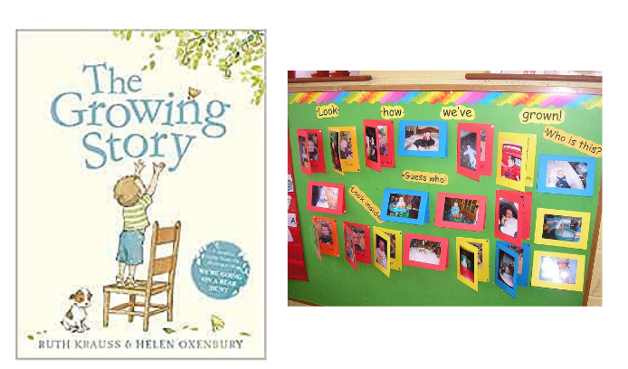
Identifying similarities and differences in different periods
How have we changed as we have grown from a baby to now? What is the same/different?
F2

Slide 20
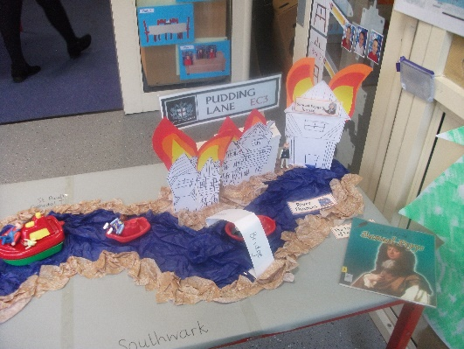
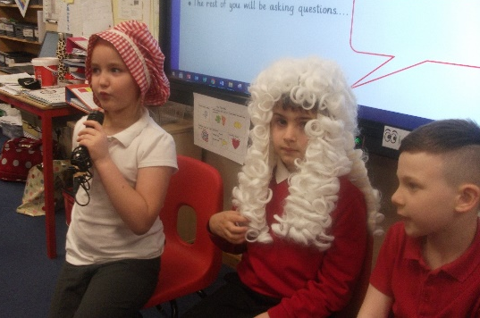
Supporting pupils with SEND
Planning/work scrutiny showed that sometimes, these pupils had been given several ‘cut and stick’ type of activities during a topic/sequence of work.
We have had a whole school focus on ‘teaching from the floor’ (through our firm belief there should be equity in our curriculum) to ensure that every child can access the content taught, and also to retain ‘sticky knowledge’.
It can be difficult to find something all children can do independently, as the teacher is often the only adult in the room (as foundation subjects take place in the afternoon, when teachers are providing ELS Phonics interventions).
We have tried to think creatively and find other ways children can ‘show what they know’, such as role play activities, guided group sorting activities, working in mixed ability groups to complete a poster (for example) or videoing their presentation.

Slide 21
Attainment data: what does it show?
This is last year’s (2021-22) data from Insight.
Y2 in particular had a lower ability cohort, with a high proportion of SEND children.

Slide 22

Pupil voice: what do our children say?
“You’re not supposed to give up, dream big, aim high!” Year 1 PP pupil, discussing Scott’s expedition
“This morning is in the past.” Y1 pupil, being questioned about the meaning of ‘the past’.
“We can find out about things that happened a long time ago through artefacts left behind, there’s a museum with these things in.” Year 1 pupil, discussing Scott’s expedition
“I like history because I like learning about the past.” Year 1 pupil.
“We remember the soldiers who died in the war on Poppy Day.” Y1 pupil, following ‘Children of WW2 topic.

Slide 23
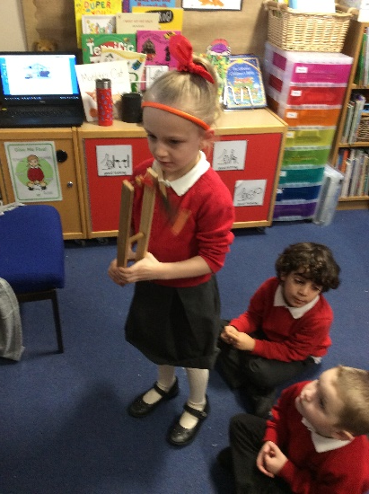
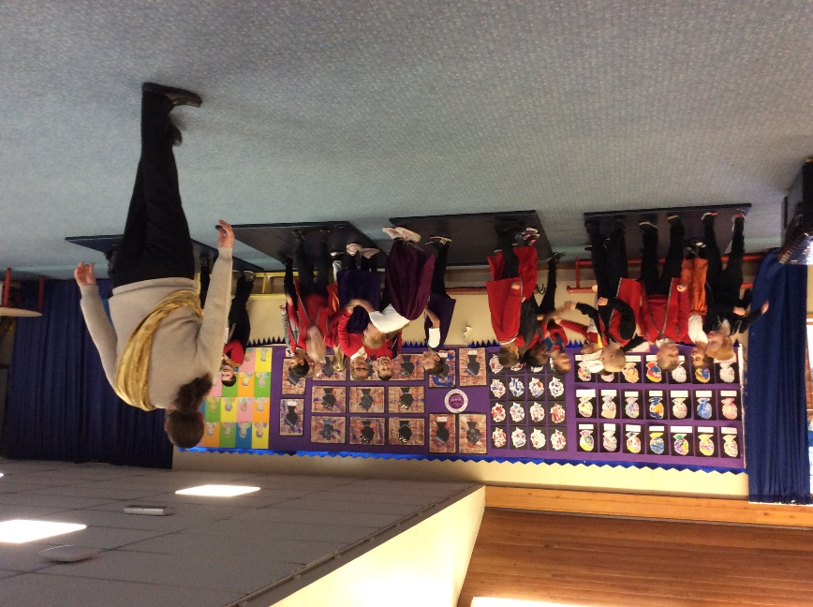
Pupil voice: what do our children say?
“The Great Fire happened in 1666, that was even longer ago than when my Grandad was alive.”
Year 2 PP pupil.
“There was a fire in Nottingham I saw on the news, but it did not spread like the Great Fire because the houses weren’t close together or made of wood.” Year 2 pupil
“Mrs Swannell was born first because her birthday was first.” F2 pupil, following Toys in the Past Topic.
“Lots of toys in the past were made of wood because they didn’t have plastic.” F2 pupil, following Toys in the Past Topic.
“Dinosaurs lived millions of years ago, before people.” Year 2 pupil

Slide 24
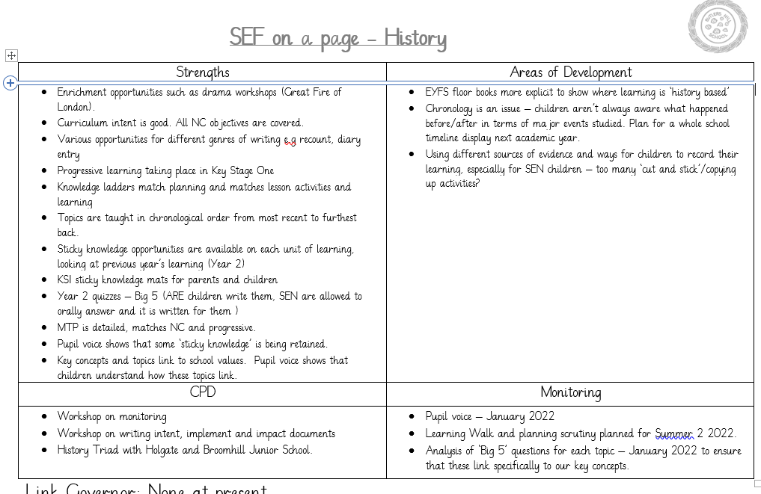
So…what next?
In F2, sources of evidence are considered when looking at different version of traditional tales e.g. ‘The Gingerbread Man’ and ‘The Runaway Chapati’.
In Autumn 2, Year 2 children participated in an online workshop with the National Archives – looking at maps and other documents used to study the Great Fire of London.
Loan boxes – Year 1 will have a WW2 artefacts box for Summer 1.

Slide 25
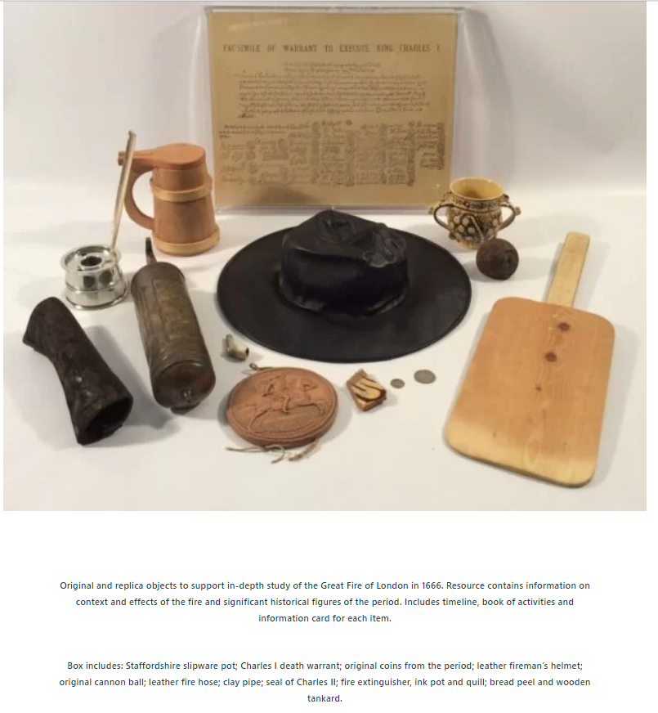
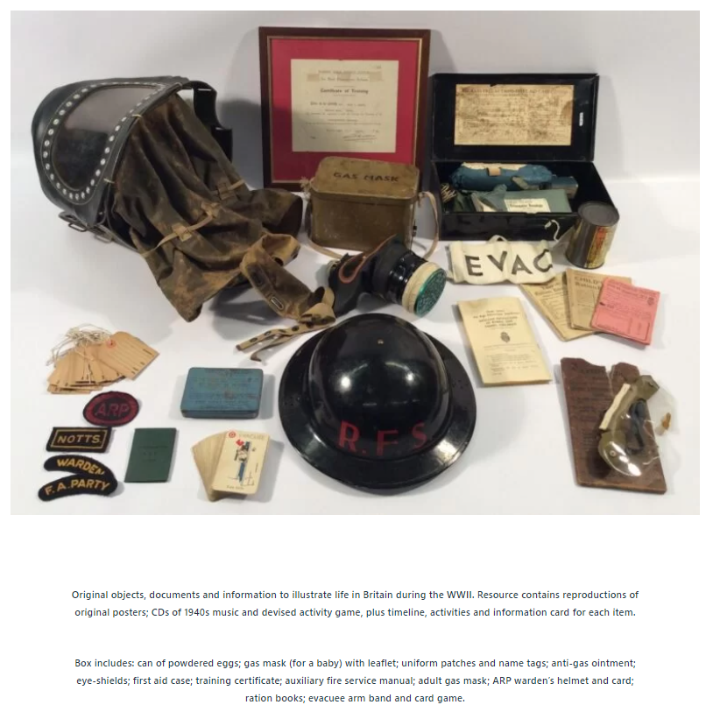
So…what next? Develop use of artefacts and sources of evidence

Slide 26


