Slide 1


SEND at Butler’s Hill

Slide 2

SEND in a Nutshell
CONTEXT
 | No. In year | Girls | Boys | SEN/ % | EHCP | SEN + PP | % PP with SEND | SEN + EAL | SEN + LAC
N | 38 | 22 | 16 | 10 – 26% | 0 | 0 | 0 | 0 | 0
R | 75 | 41 | 34 | 31—41% | 0 | 5 | 6.7% | 0 | 0
1 | 55 | 25 | 30 | 22-40% | 1 | 7 | 12.7% | 1 | 0
2 | 75 | 38 | 37 | 14 – 18.6% | 1 | 9 | 12% | 0 | 0
TOTAL | 243 |  |  | 77 – 31.7% | 2 | 21 | 8.6% | 1 – 0.4% | 0

Slide 3
Send in a Nutshell
 | Whole School SEN % | National SEN %
Overall SEN | 77- 31.7% | 13%
Funded AFN high | 5 – 2.5 %
Funded AFN Med/low | 6 ch –2.5%
Funded HLN | 6 ch –2.5%
Total funded | 17 – 7%
Pre-verbal | 6 -2.5%
EHCP | 2 – 0.8% | Further 4 requested and at stage 2
Breakdown of categories of need no of children percentage of whole school
 | SEN support | EHCP
C and I (inc; ASD) | 44 -18% | 1
C&L | 11- 4.5% | 0
SEMH | 7 – 2.9% | 0
PD | 3 – 1.2% | 1

Slide 4
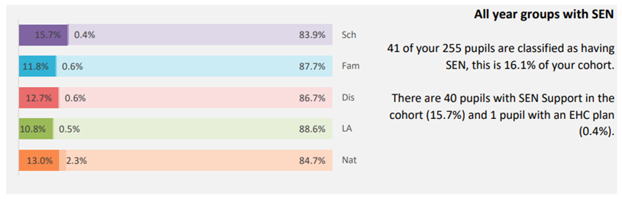
Comparison to other schools
Las

Slide 5
CPD
Trainings this year
NASENCO award
Mastering Number
Beth Atkinson SALT training
Engagement model training HN SFSS
Mental Health – for staff and Emotion Coaching Zoe Brown
SFSS Sensory regulation
Lightbulb
Supporting Chilldren with ADHD in the Primary Classroom
SEND in the curriculum
Sensory Circuits
Forest school

Slide 6
Interventions
Catch Up Literacy/Maths
ELSA/Motional Nurture interventions
Let’s Talk Nurture
ELS Phonics interventions
WELLCOMM
Colourful Semantics SALT
Attention Autism
Intensive Interaction

Slide 7

AFN and HLN– requests for funding
AFN – High approx £5000/year
- Medium £3500/year
- Low £1500/year
HLN - £12,000/year
15 bids For AFN this year
8 bids for HLN

Slide 8
Holgate Family of schools - activity
Springboard
Termly family meetings
Additional funding
Support

Slide 9

Outside agencies Butler’s Hill works with.
SFSS
SBAP
SALT
EP
PDSS
Chatter

Slide 10

EHCP
A summary document which details the child’s views, strengths, special educational needs, and how to help the child/young person reach the identified outcomes
School with parents apply for the plan
Lengthy process
If a child needs a special school, they need this
Draws on reports from school, home, paediatrician, and Educational psychologists, and any other outside agencies

Slide 11
Getting to Know me Form and the Concerning Behaviour Pathway
Generated by parent or school if a child is demonstrating concerning behaviours
A form that outlines a child’s strengths and difficulties
Different tiers of support
Level 1 – IEPs, SALT, sleep workshops, I23 magic
Level 2/3 – Advanced parenting courses, specialist practitioner
24 month wait to be assessed by NBS (what was Small steps) questionnaire we sometimes get
Fast track if under 5, well below age related. Sometimes can fast track if there is self harm
Fast track is a 12 week wait
SENCO, parent, HFT, class teacher meet to discuss options

Slide 12
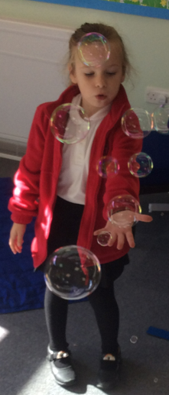
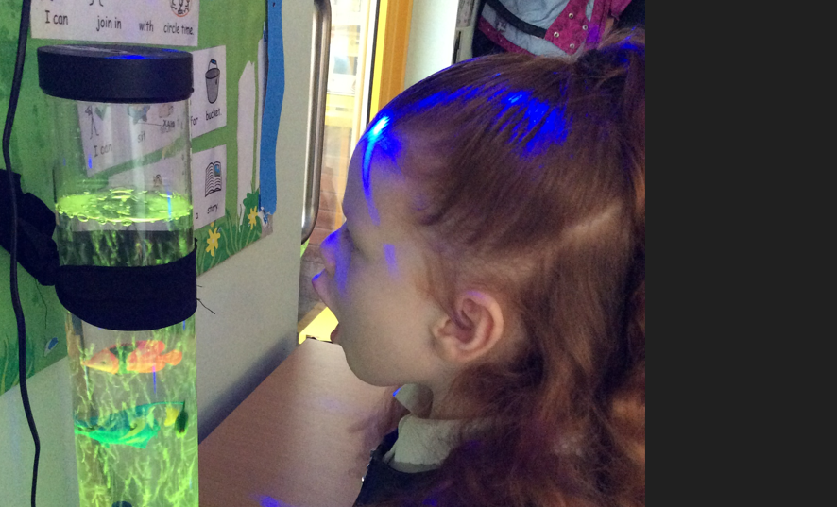
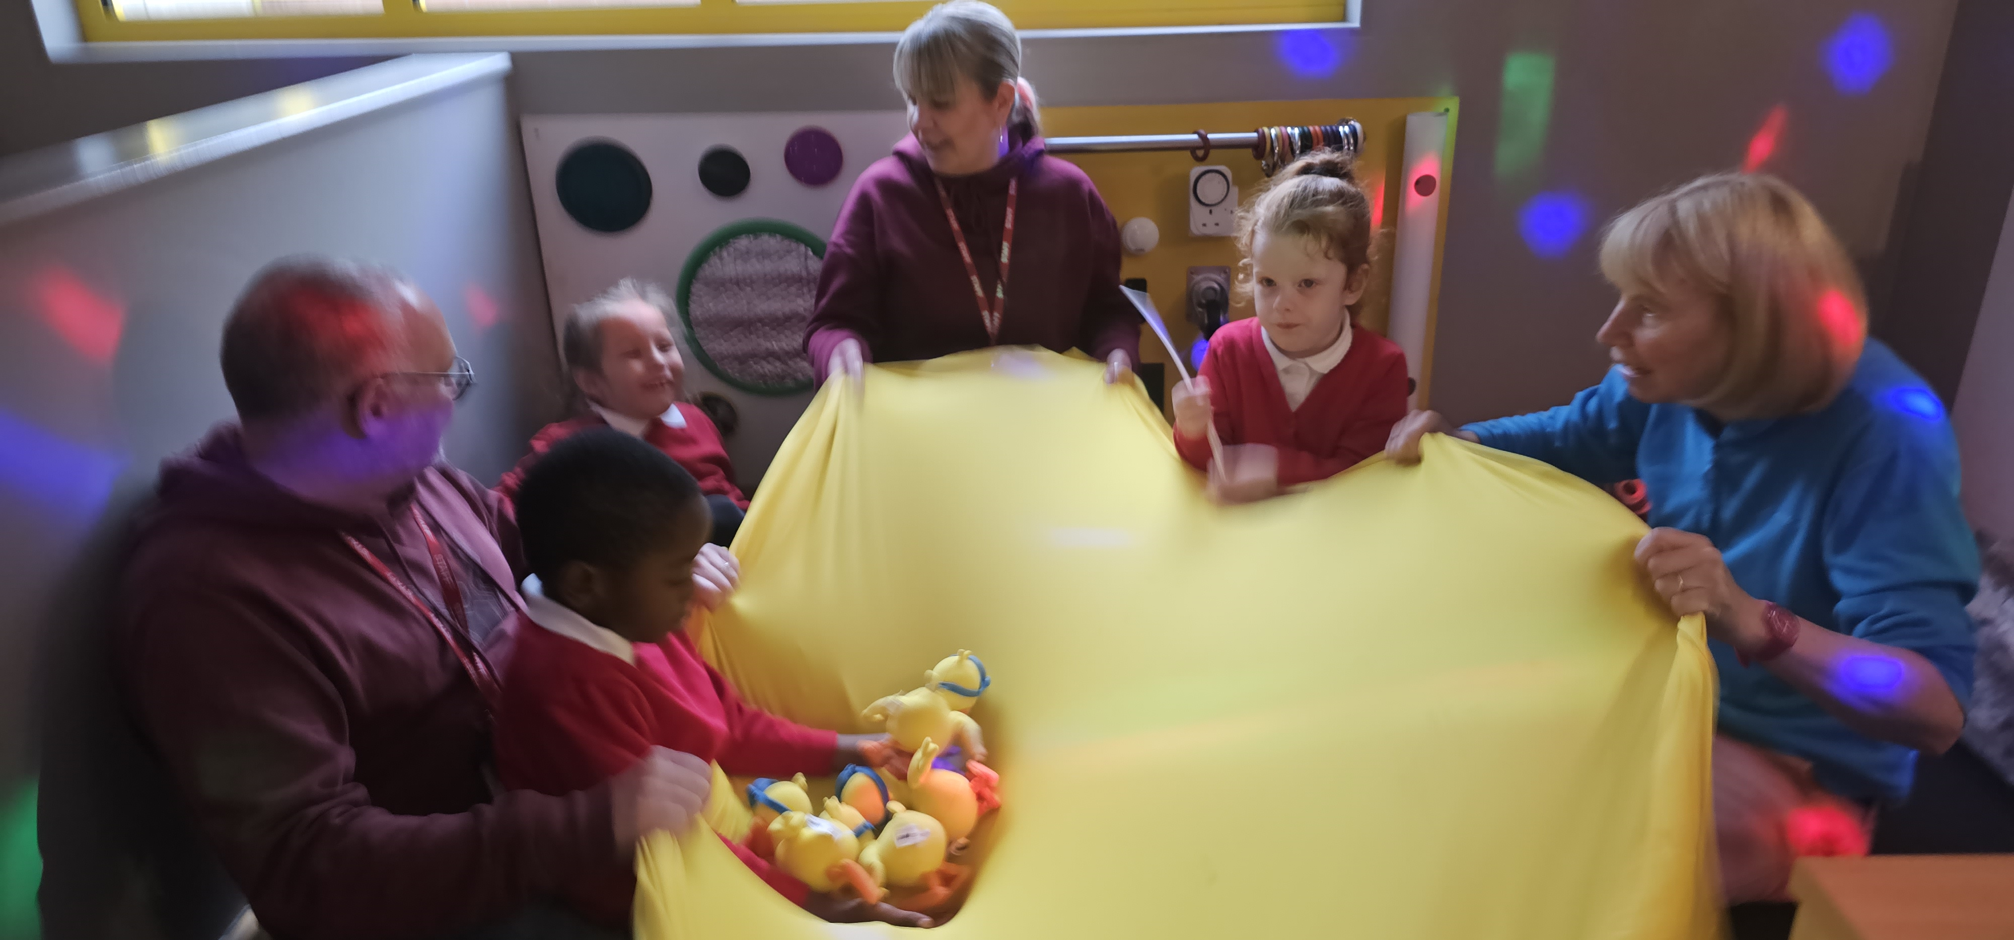
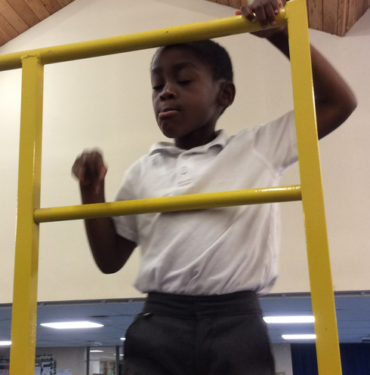
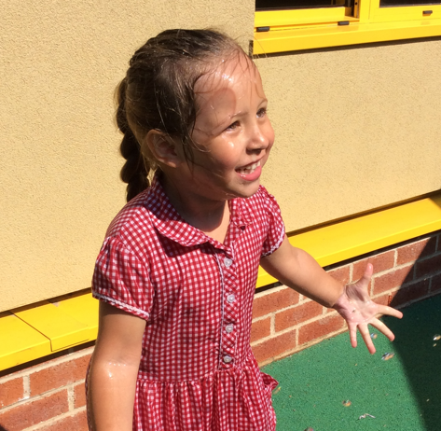
Rainbow room

Slide 13
Rainbow Room
Currently preverbal children with ASD and high level sensory needs
Overseen by the SENCO
Managed by an experienced TA with expertise in Speech and language
Intensive Interaction
Sensory diets and circuits
Attention Autism style intervention

Slide 14
Inclusion and the Rainbow room
These children get very distressed when integrated into our mainstream classrooms. Their high level of sensory need means they quickly become deregulated by noise, busy environments and unfamiliar people
Most of them have Special named on their EHCP plans and some have placements for next Sept. More EHCPs are planned this year
The children all spend time in F2 during freeflow
The children visit their peer group for PE, Music, story, reward times where there is free choice, snack time, play time, trips, immersing days, special days

Slide 15
Rainbow room - aspirations
We want our children to become independent in self care. E.g. dressing, toileting
We want our children to learn to tolerate other people playing and working alongside them
We want them to accept direction from a trusted adult
We want to enrich their experiences – trips, sensory experiences, etc
We want them to learn to communicate their wants and needs through pictures, signing or other
We want them to feel like they belong to a school, class, group

Slide 16
F2 specialist provision for children with significant communication and interaction difficulties or developmental delay
Attention Autism style approach
Small group
Signs and symbols
Phonics
Maths

Slide 17

Quality First Teaching
Quality First Teaching (QFT) is a style of teaching that focuses on high quality and inclusive teaching for every child in a classroom. Quality First Teaching relies on a variety of learning strategies in order to be effective, like differentiated learning and the use of SEND resources. In short, QFT is an approach that highlights the need for a personalised learning experience and encourages greater inclusion of pupils with SEND needs.
Reasonable adjustments
Personalised teaching
Appropriate use of scaffolding
Good knowledge of children and their barriers to learning
Improving children’s independence
Our SIP is focussing on ensuring Quality First teaching, and we are working hard to ensure these principles are embedded in our practice. Staff’s appraisal is linked to this objective. Staff will be given research driven CPD to develop their teaching. Observations will look for QFT. Less activity based, more learning based. Children to be scaffolded to learn and be encouraged to work at their level independently.

Slide 18
Use of support in school
Teaching assistants are used to provide additional support for all pupils
Some children require a high level of support. In some cases 1:1
scaffold children’s learning and encourage children to be independent. They carry out interventions in the afternoon.
All children, including those with SEND remain the responsibility of the class teacher.

Slide 19
Assessment and Tracking
Track the progress of all children at least termly
Identify any children who are not keeping up and deliver an intervention
Any child who isn’t making progress or is working well below age related expectations will be given an Individual Education Plan with up to 4 targets
Bsquared helps us track smaller levels of progress and target the gaps in children’s understanding

